Slide 1

Notes:
# Hi
Thanks for the introduction, I am Jérome Eertmans and I will present our work on comparing differentiable and dynamic ray tracing.
This work was done in collaboration with the University of Bologna and UCLouvain.
All the materials, including the slides, are available on GitHub or on my personal website, links at the end.

Slide 2
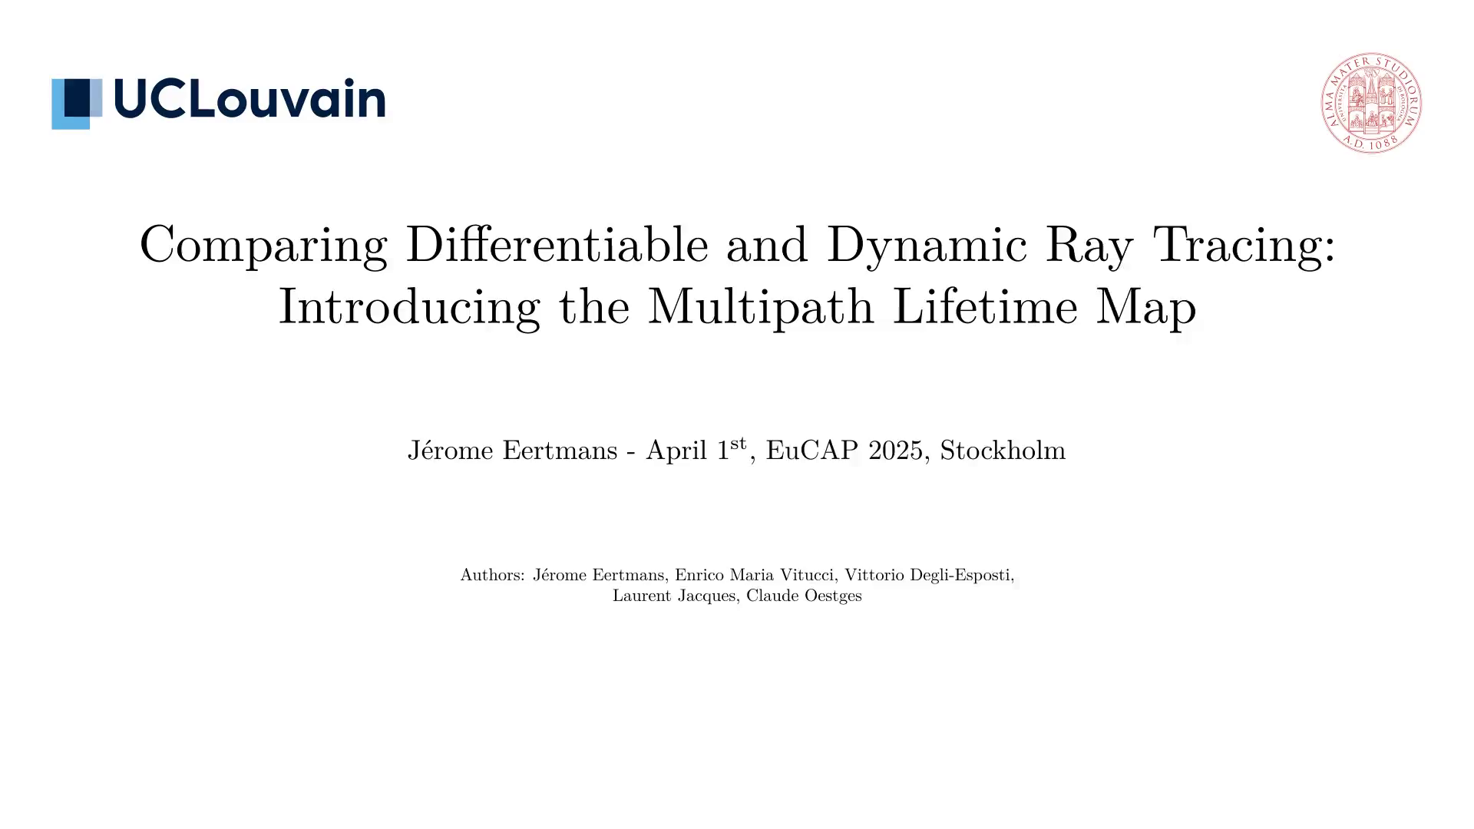
Notes:
# Context
We are interested with radio propagation modeling.
As technologies evolve, the need for simulating dynamic scenes increases.
Indeed, more and more applications assume an environment that is not static, where antennas
and reflectors are moving.

Slide 3
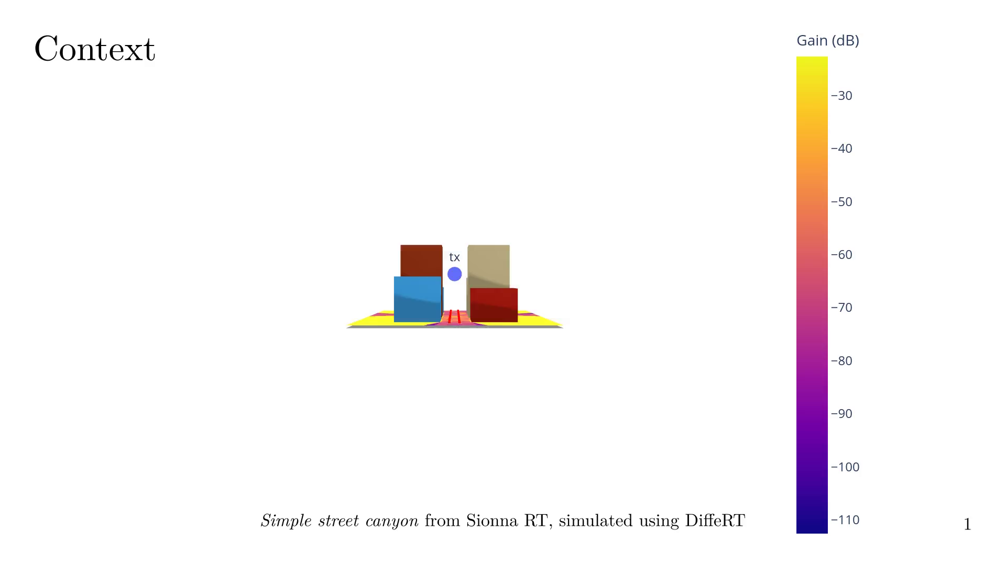
Notes:
## Context examples
In this example, we have a street canyon with many cars that are moving.

Slide 4
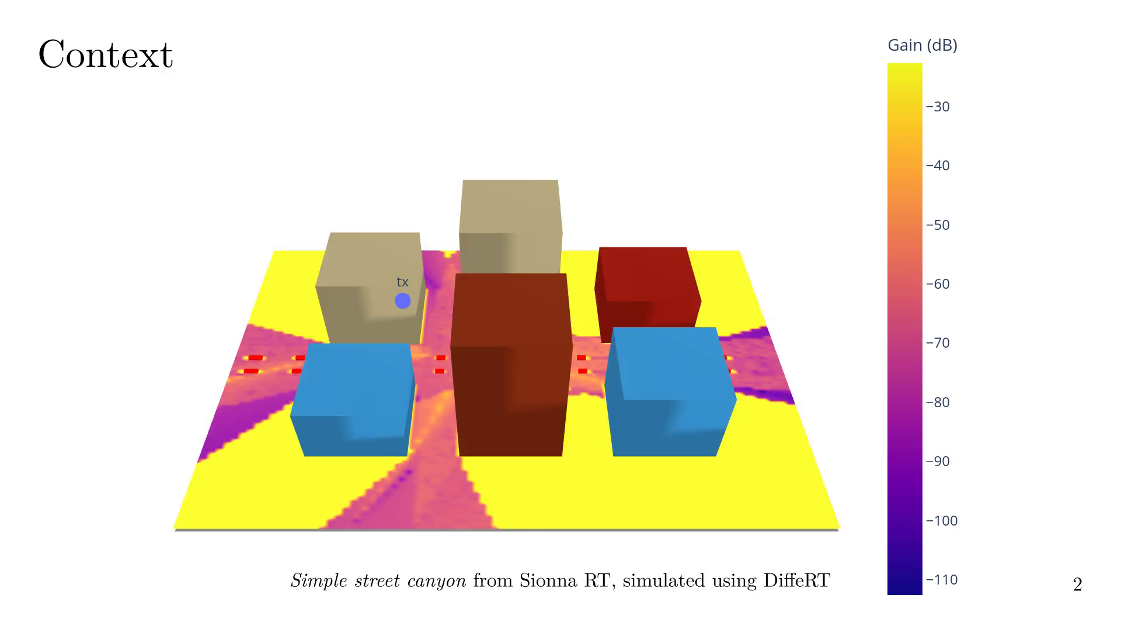
Notes:
When using an idiomatic Ray Tracing (RT) approach, we need to recompute paths for each
scene variation, which become computationally expensive.
While Ray Tracers and computers have become faster, recomputing all the
paths everytime may not be the smartest approach.

Slide 5

Notes:
Dummy slide after loop

Slide 6

Notes:
Let us recall the basics of Ray Tracing.
A scene can be representated at any time as... some TX, some RX and some objects.

Slide 7
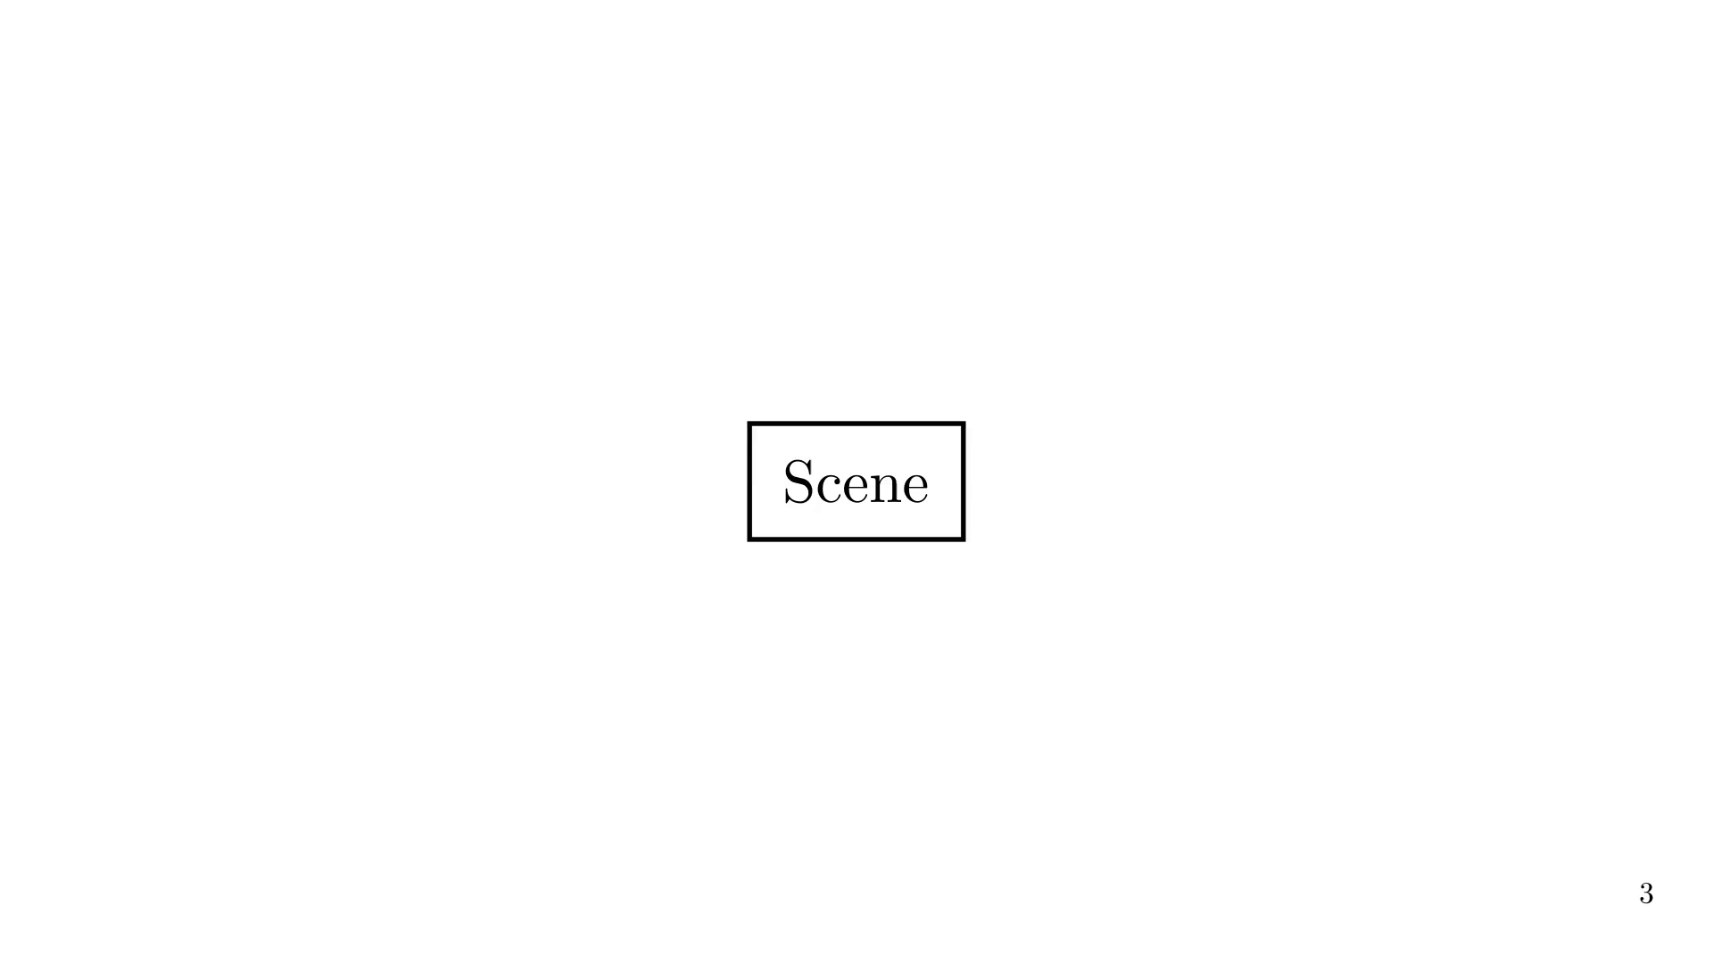

Slide 8
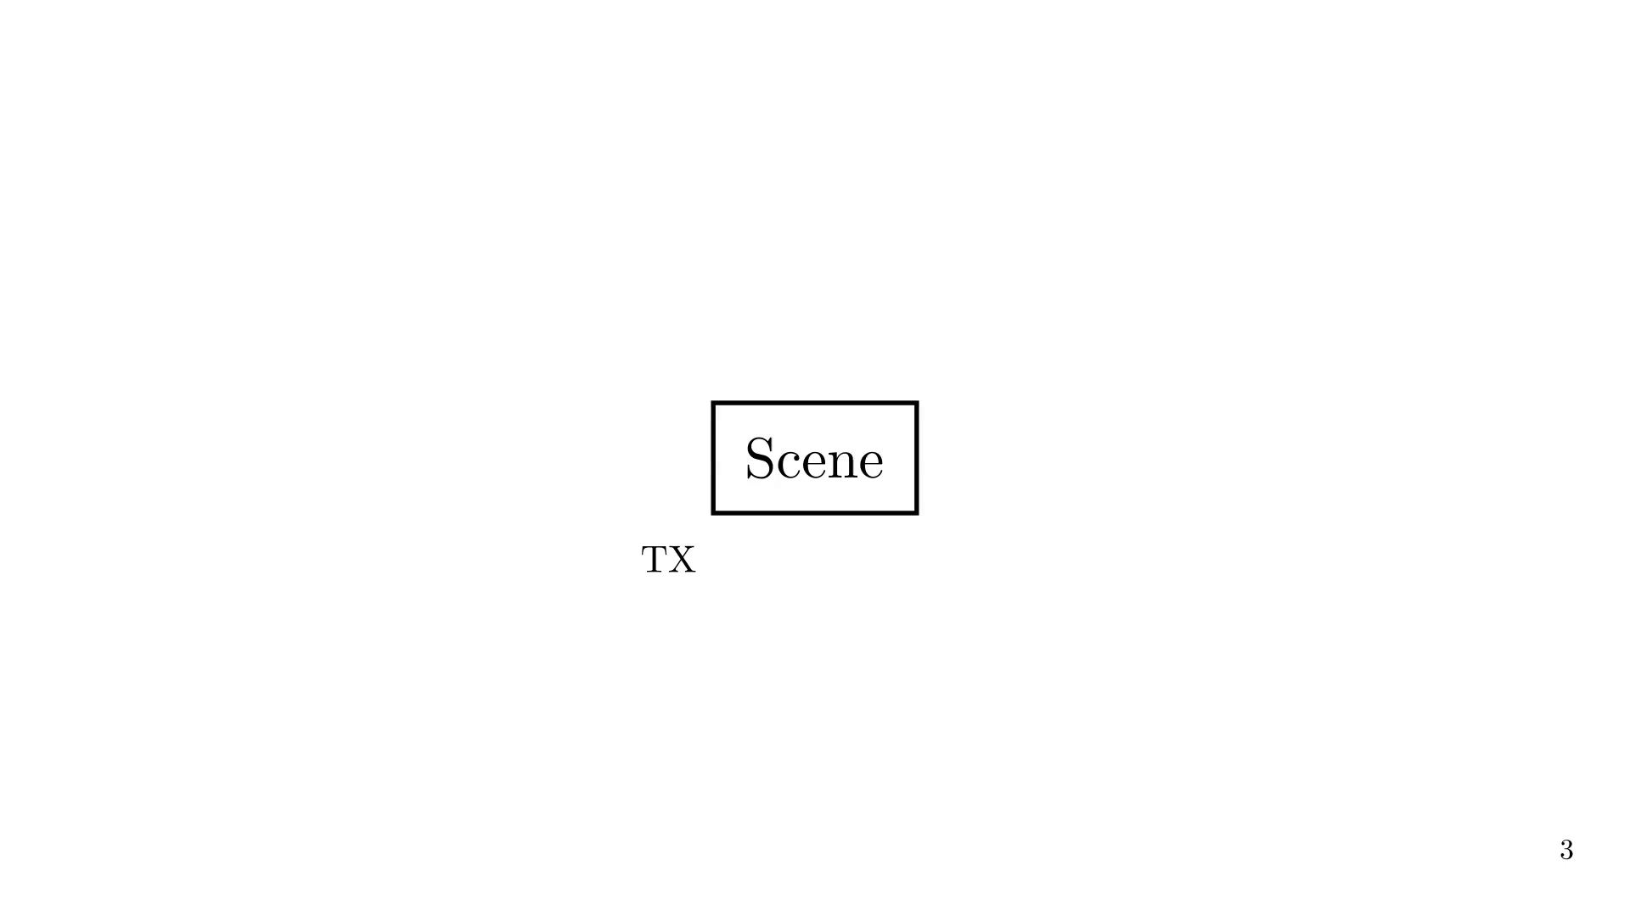

Slide 9
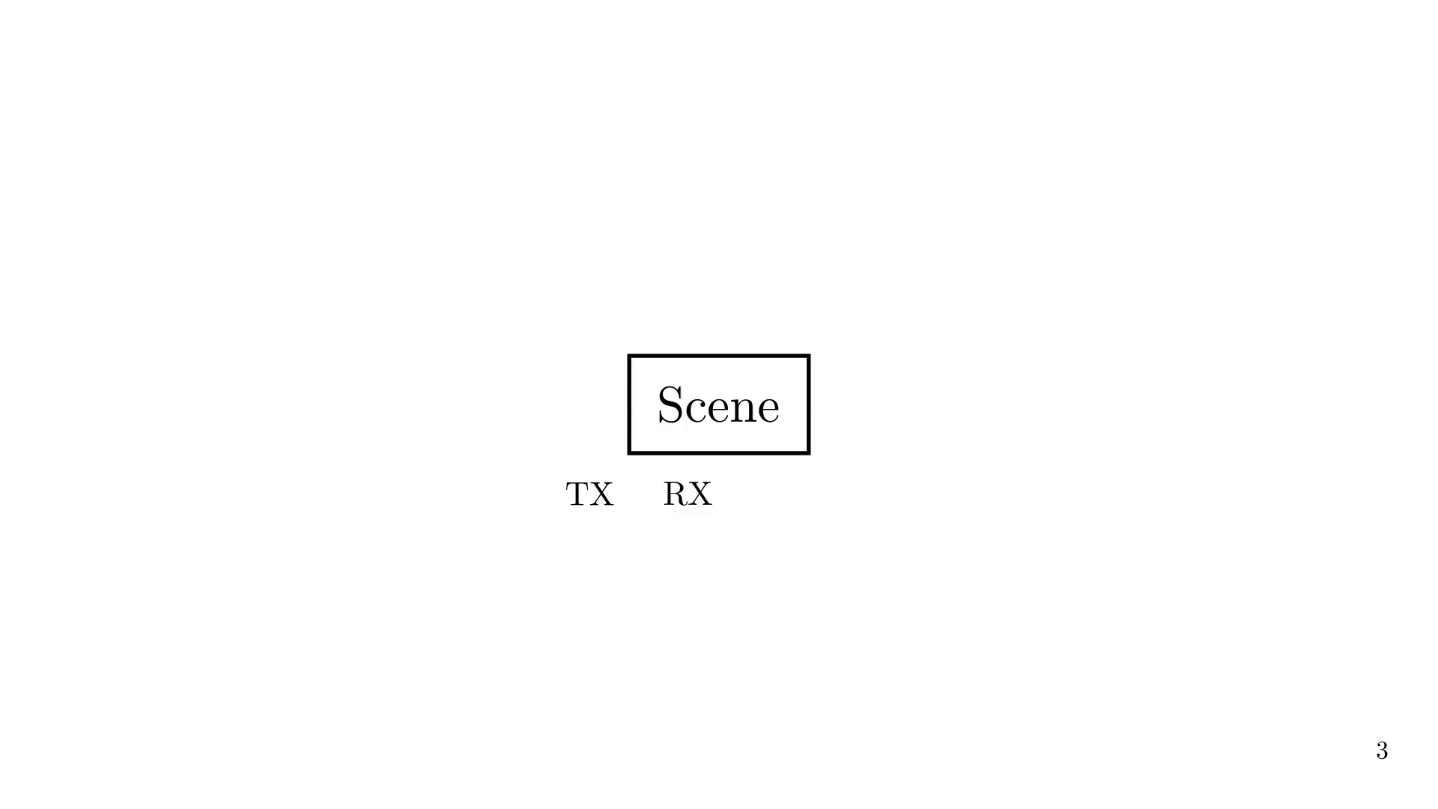

Slide 10
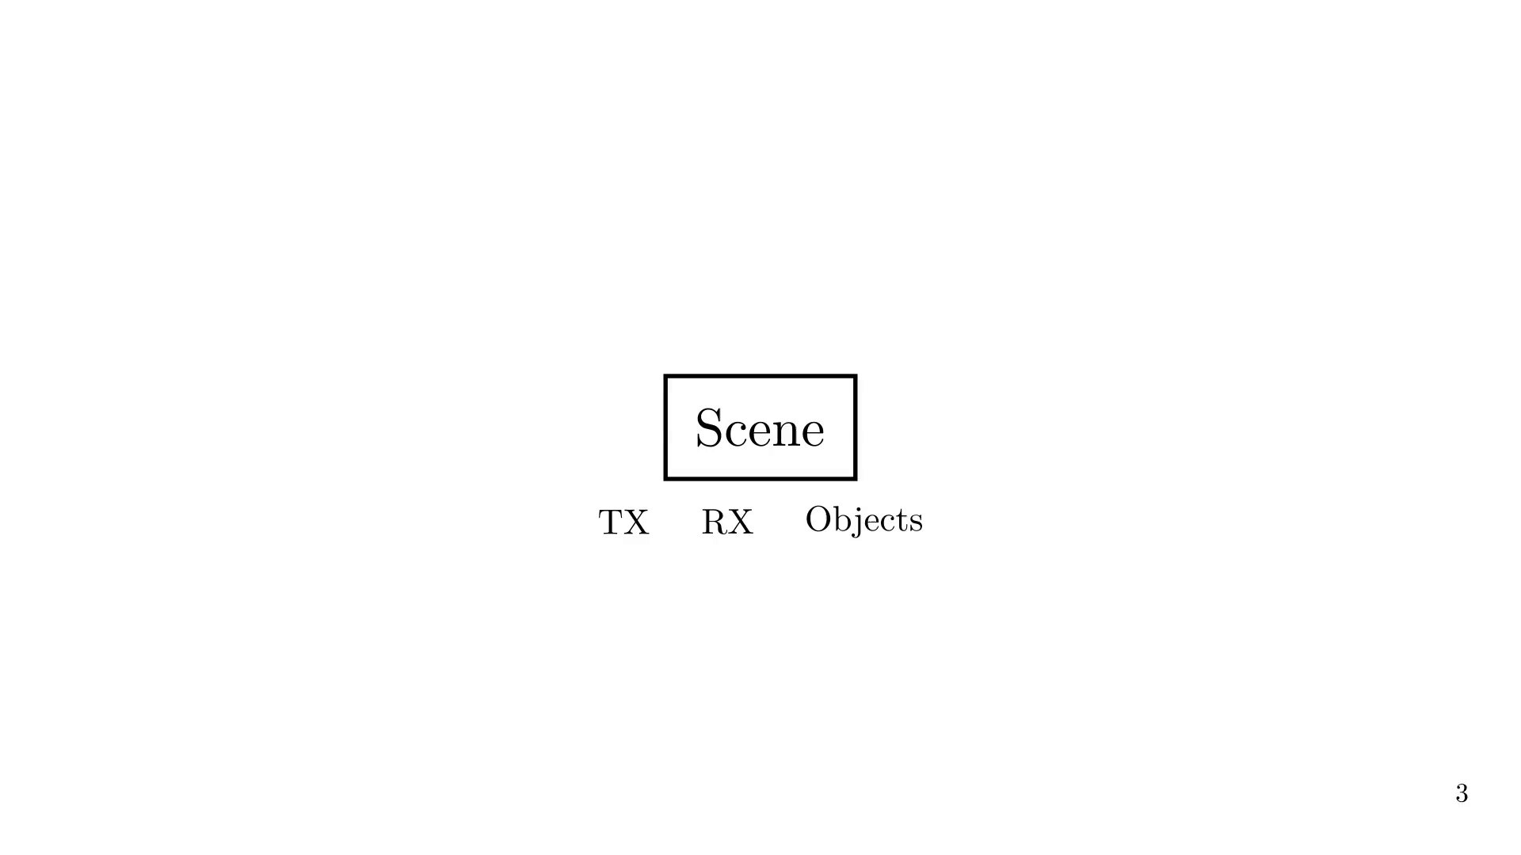
Notes:
We then trace the rays between TX and RX

Slide 11
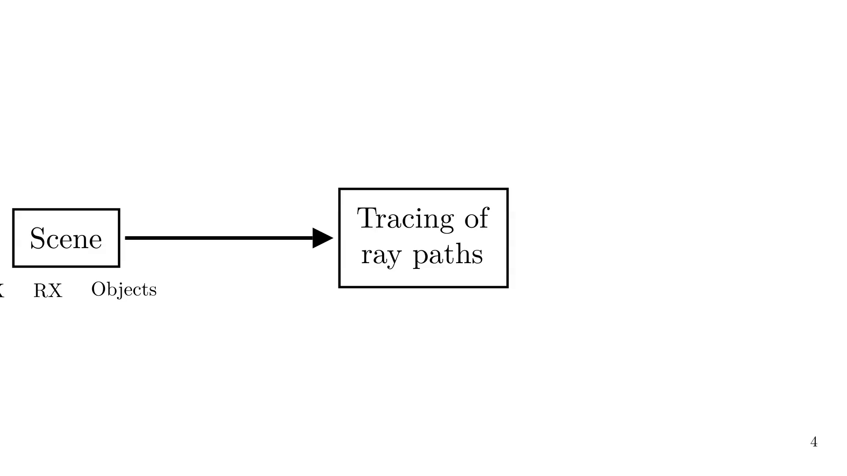
Notes:
And, using each reach ray, we compute the EM fields

Slide 12
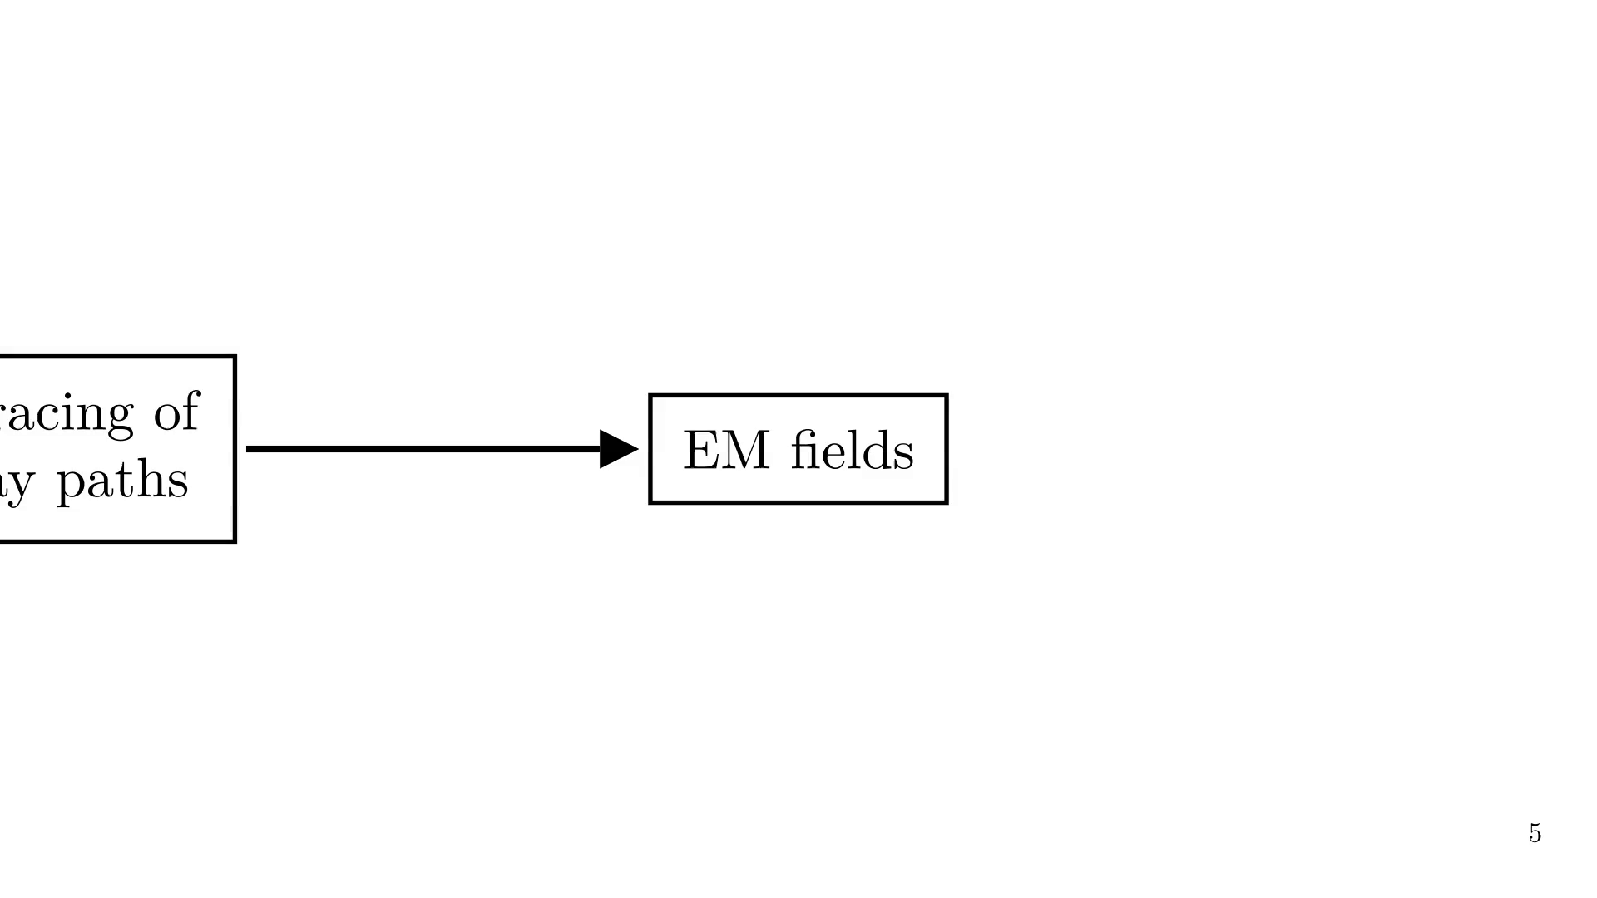
Notes:
E.g., EM fields can be used to compute the coverage map

Slide 13
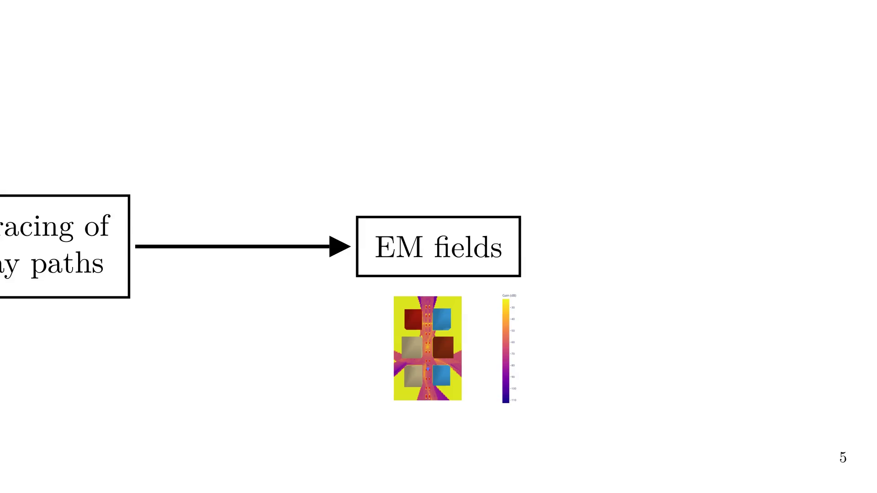
Notes:
If you look at the bigger picture, radio-wave propagation through RT is a two-step process.

Slide 14
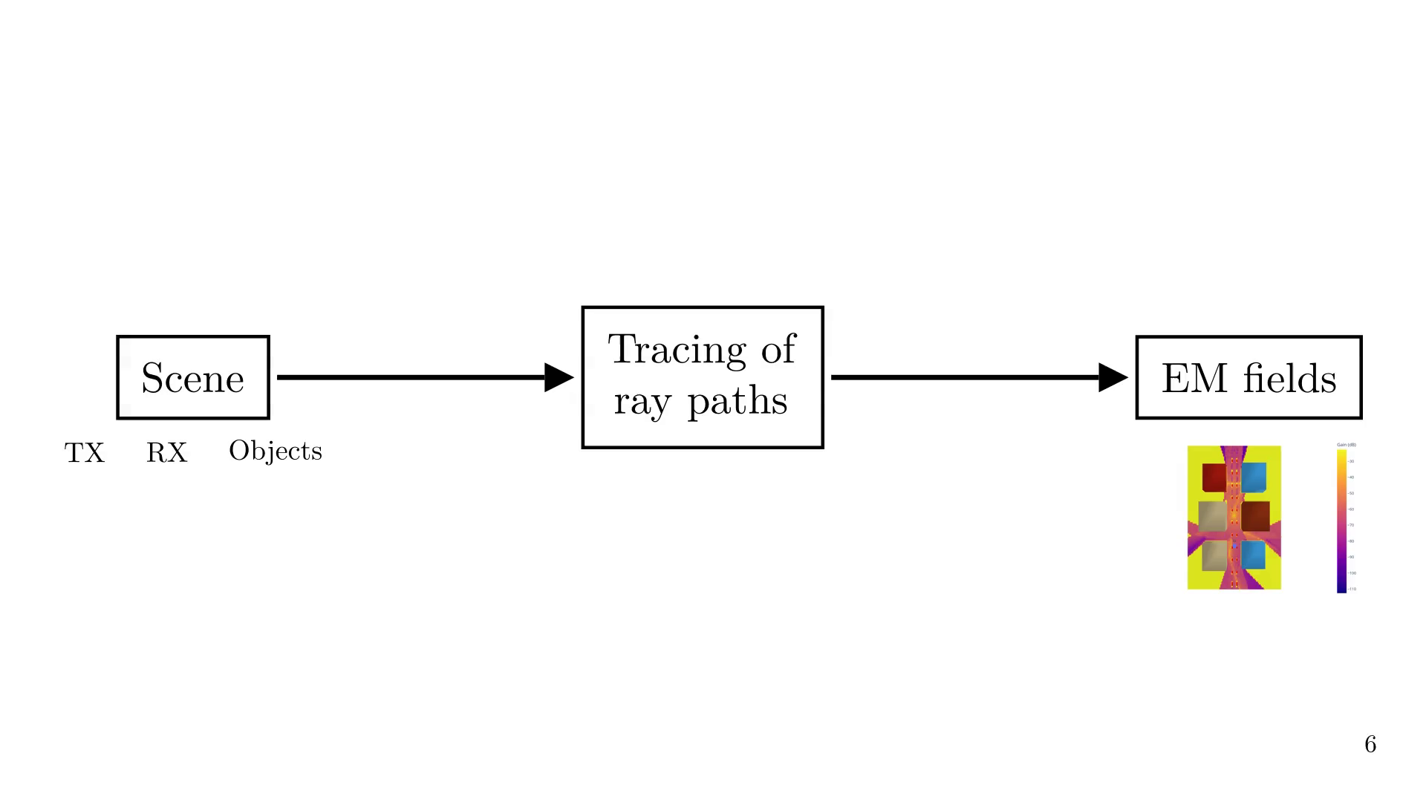
Notes:
## Dynamic scenes
What happens when we change the scene?
As just said, we could recompute the rays and EM fields, but this is expensive.
If the scene only scene changes a little, a suggestion is that we could use the previous rays or EM fields,
and local derivatives, to predict the new rays or EM fields.

Slide 15
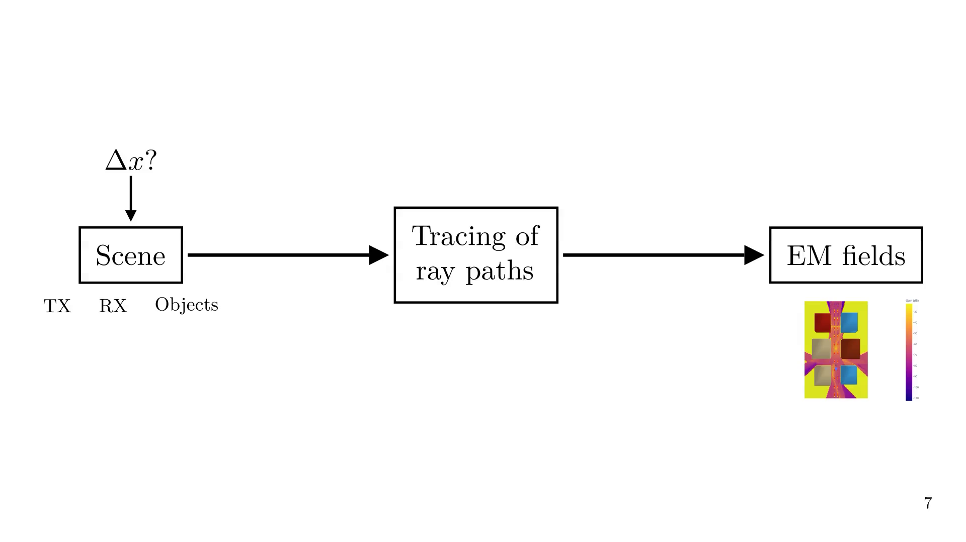
Notes:
We have two approaches

Slide 16
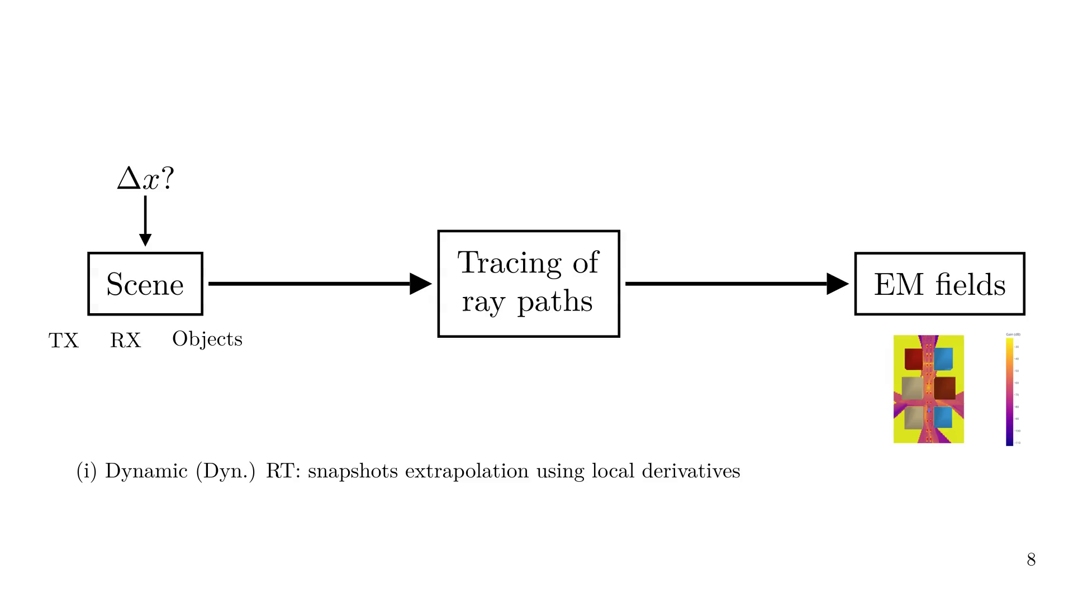
Notes:
If we name the path tracing step as f(x).

Slide 17
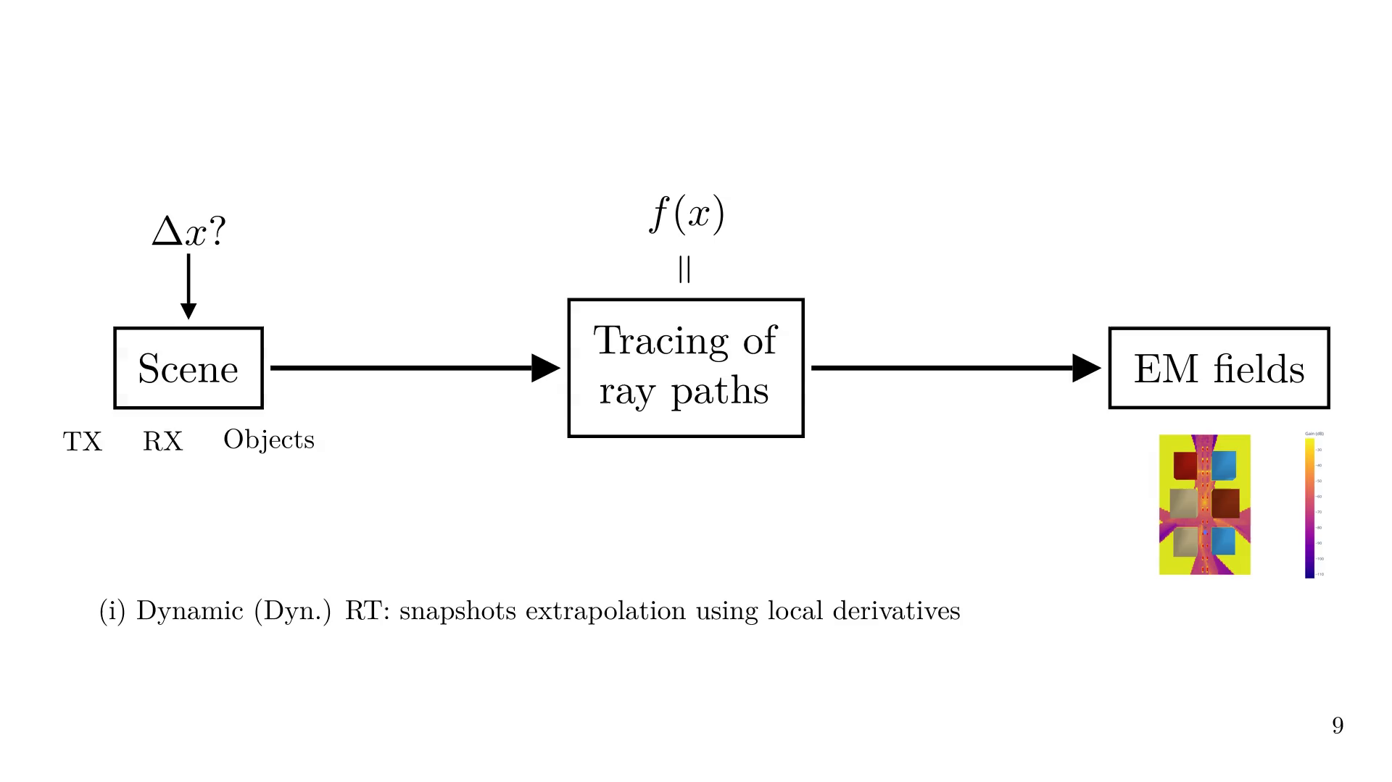
Notes:
And a full RT simulation as a 'snapshot'

Slide 18
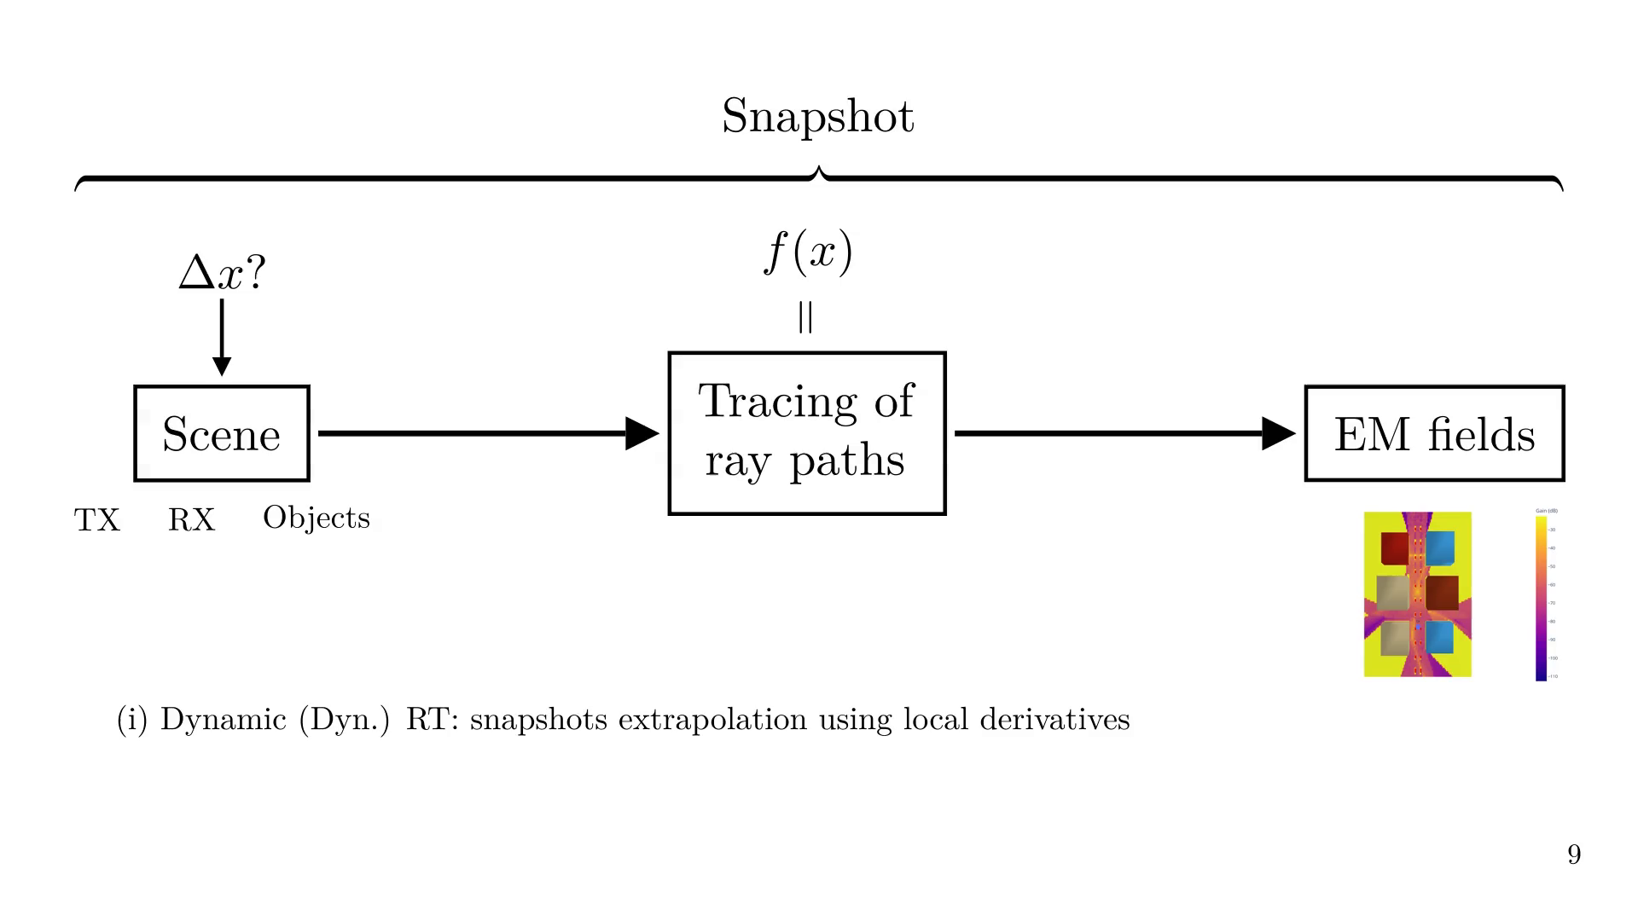
Notes:
Then we extrapolate future snapshots using previous ones and local derivatives

Slide 19
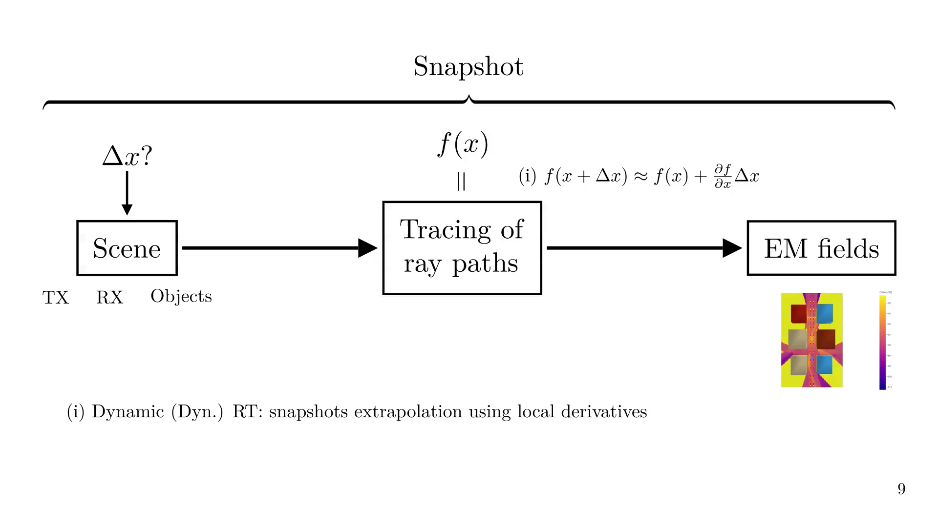
Notes:
Diff. RT is about being able to differentiate any function of our code with respect to any parameter.

Slide 20
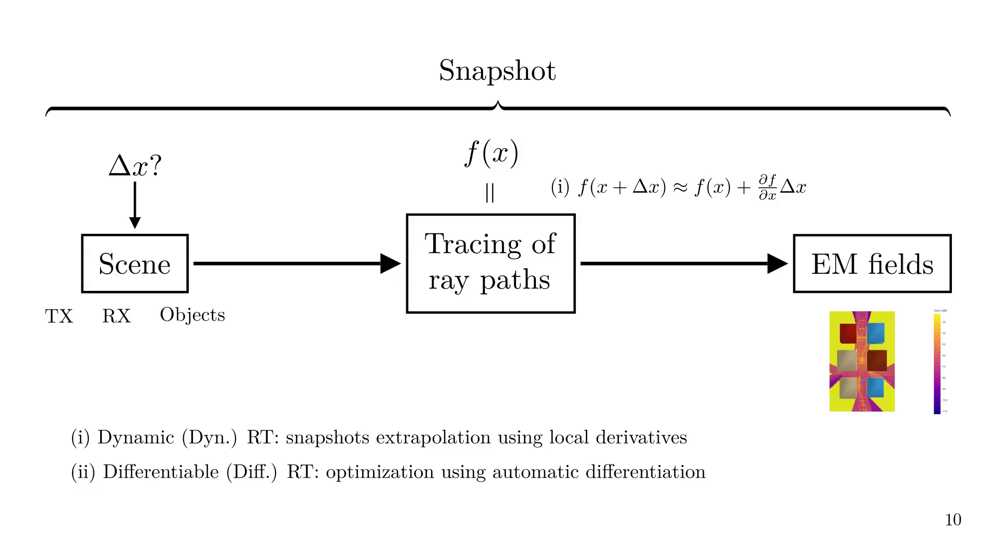
Notes:
E.g., we define an objective function g(x), here, the power.

Slide 21
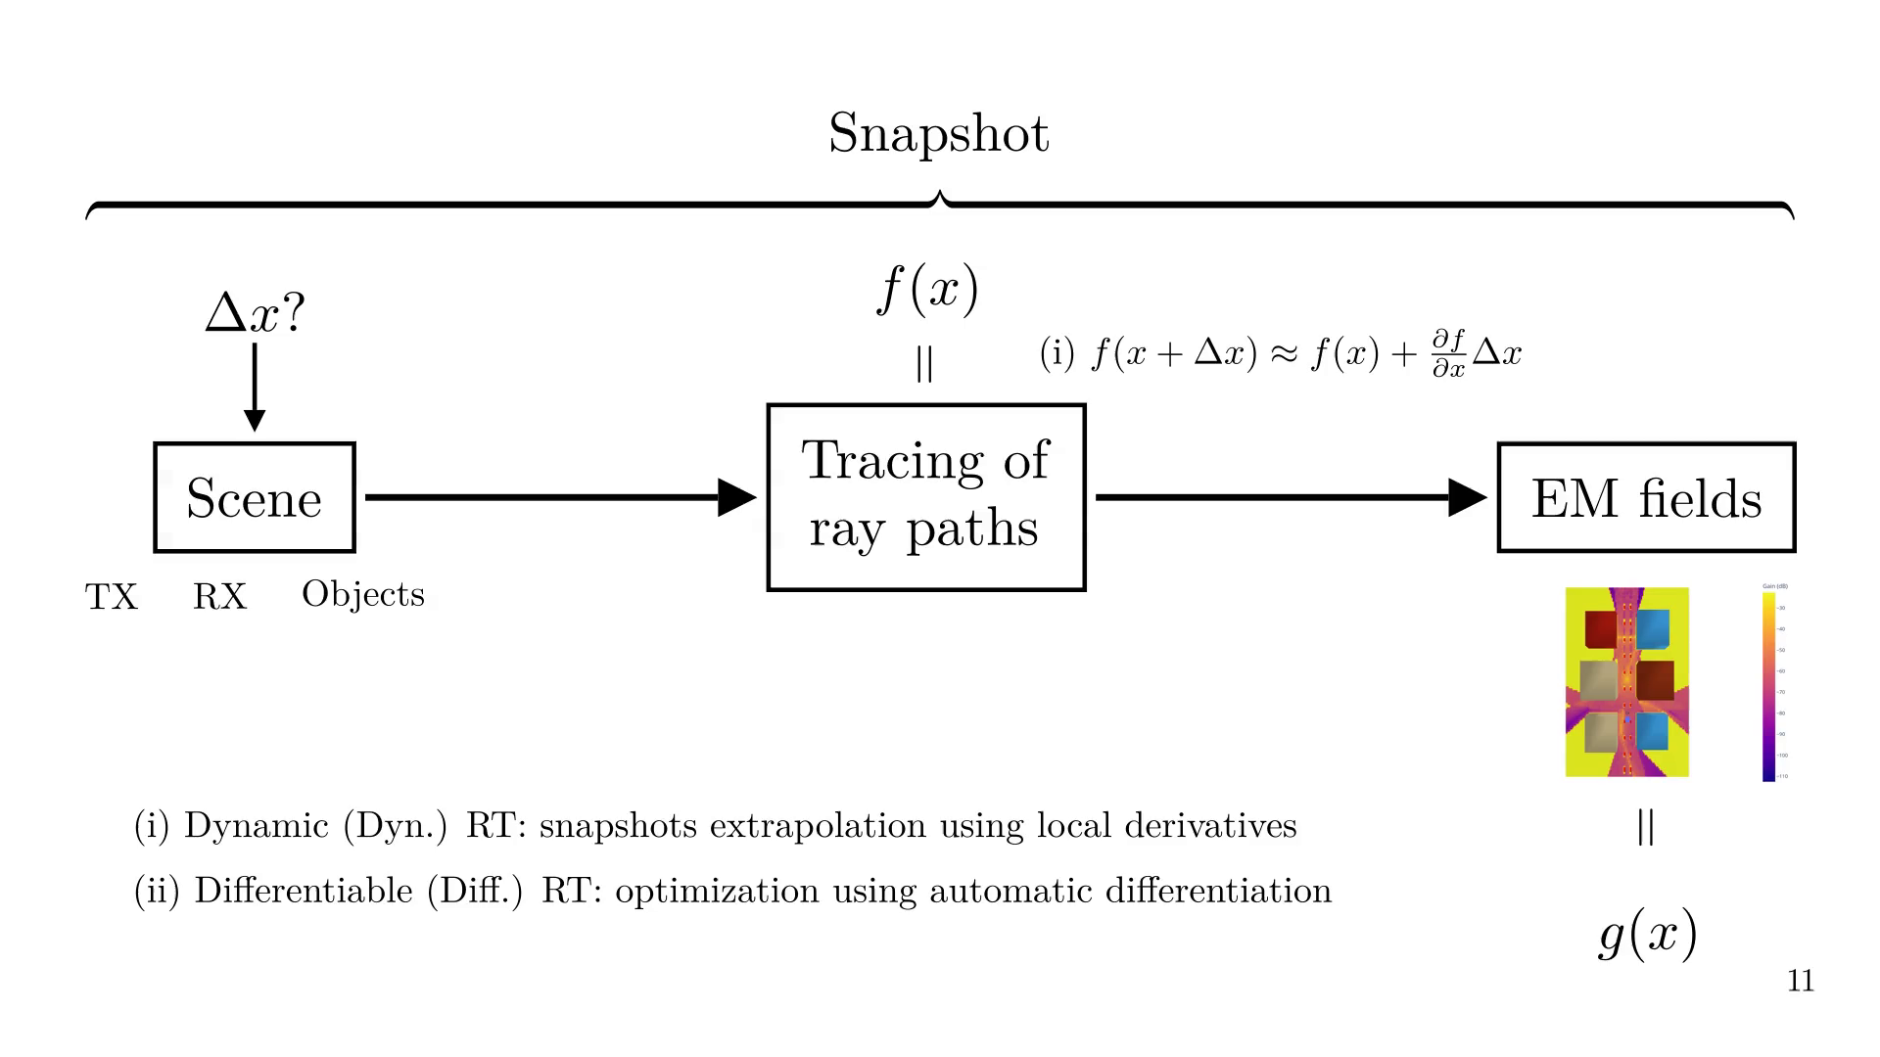
Notes:
And use AD to perform gradient descend to find the optimal parameters.

Slide 22
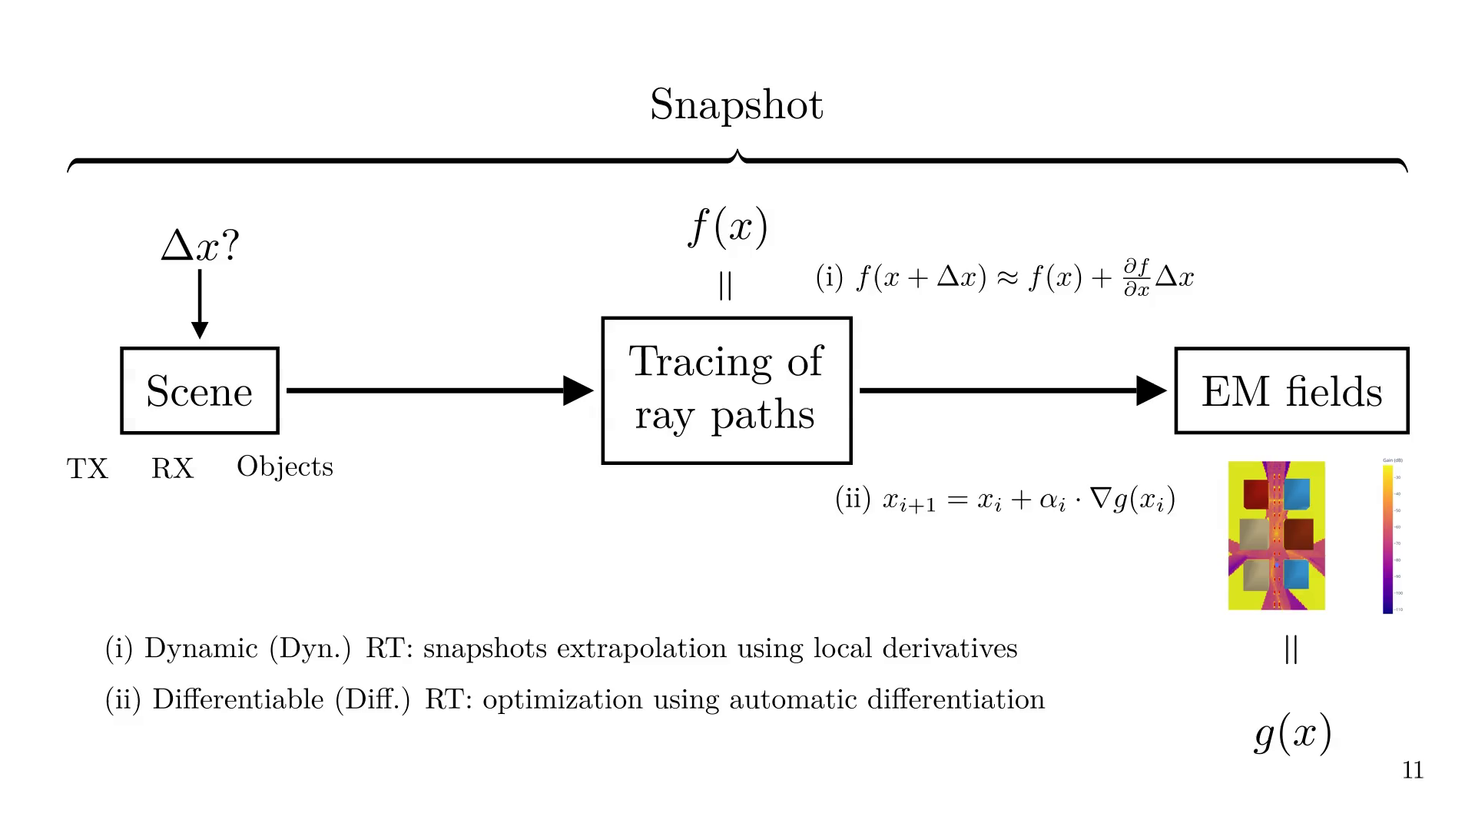
Notes:
We observed the following limitations:

Slide 23
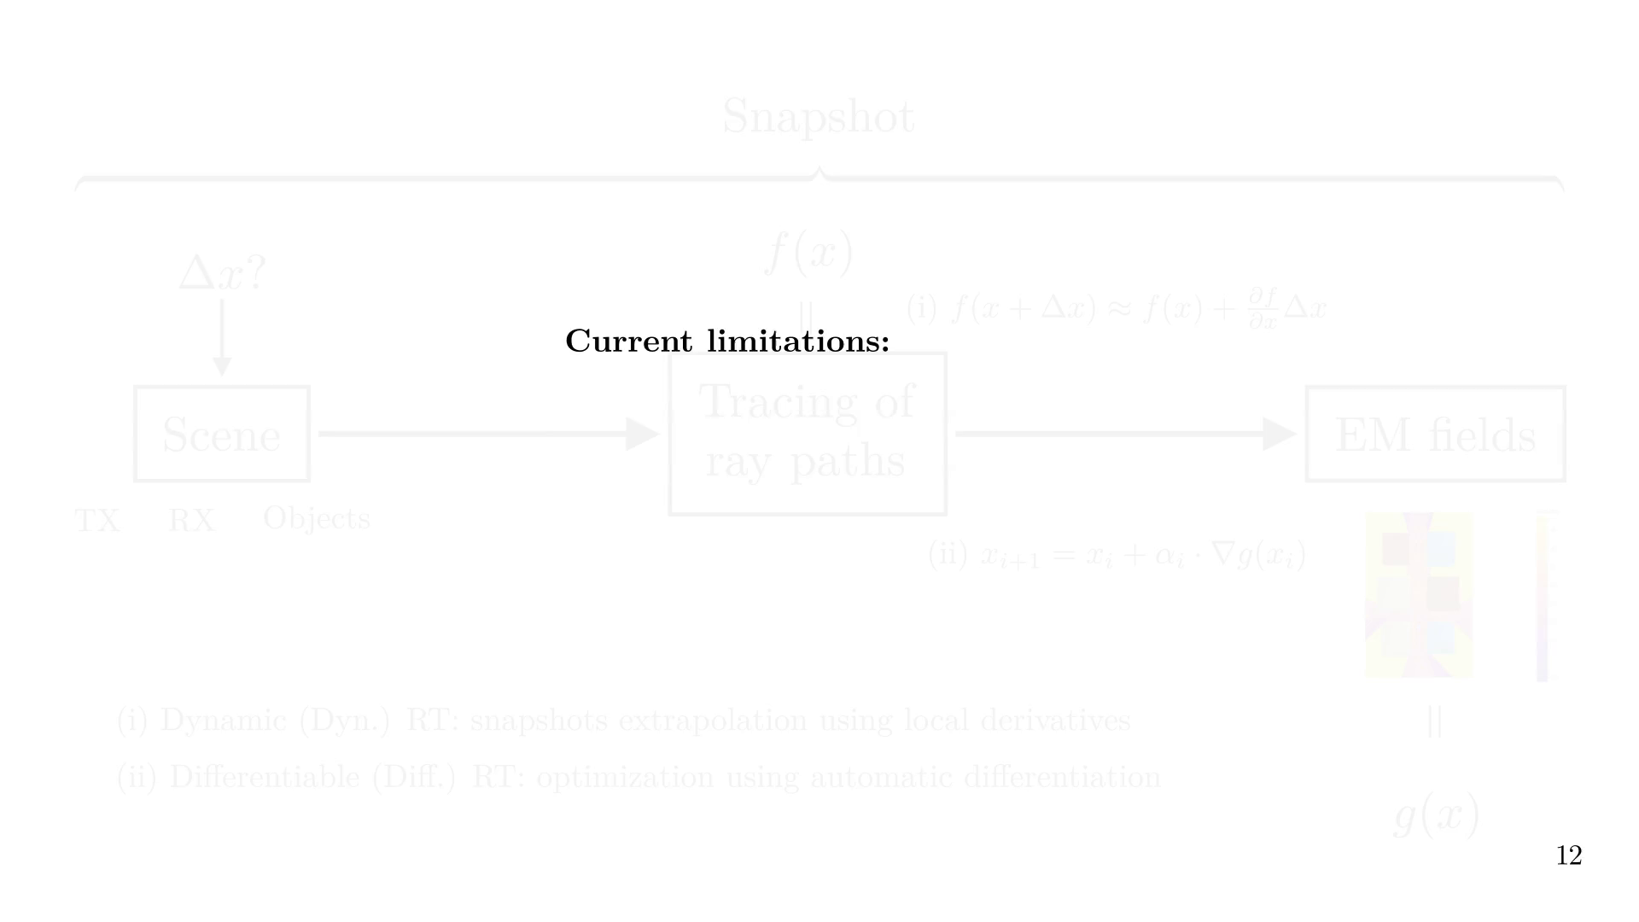

Slide 24
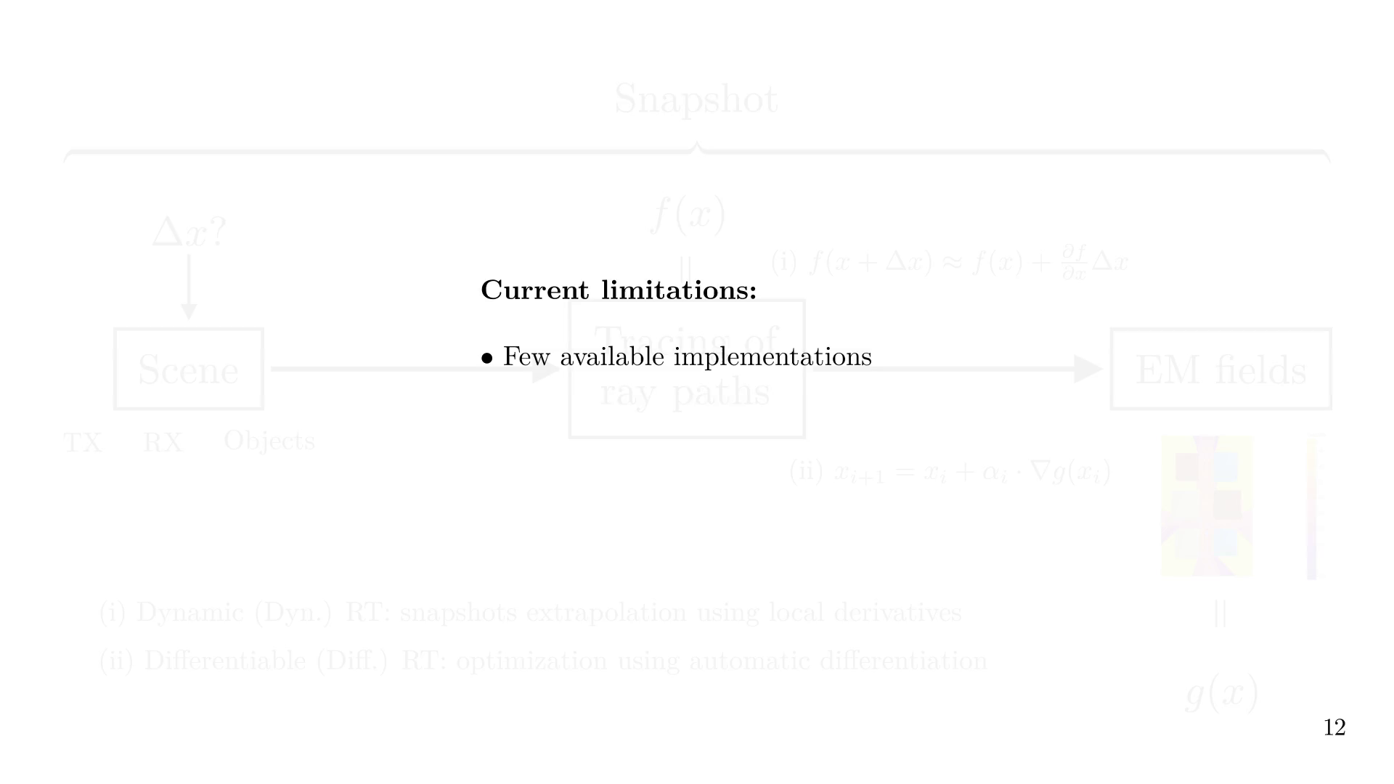

Slide 25
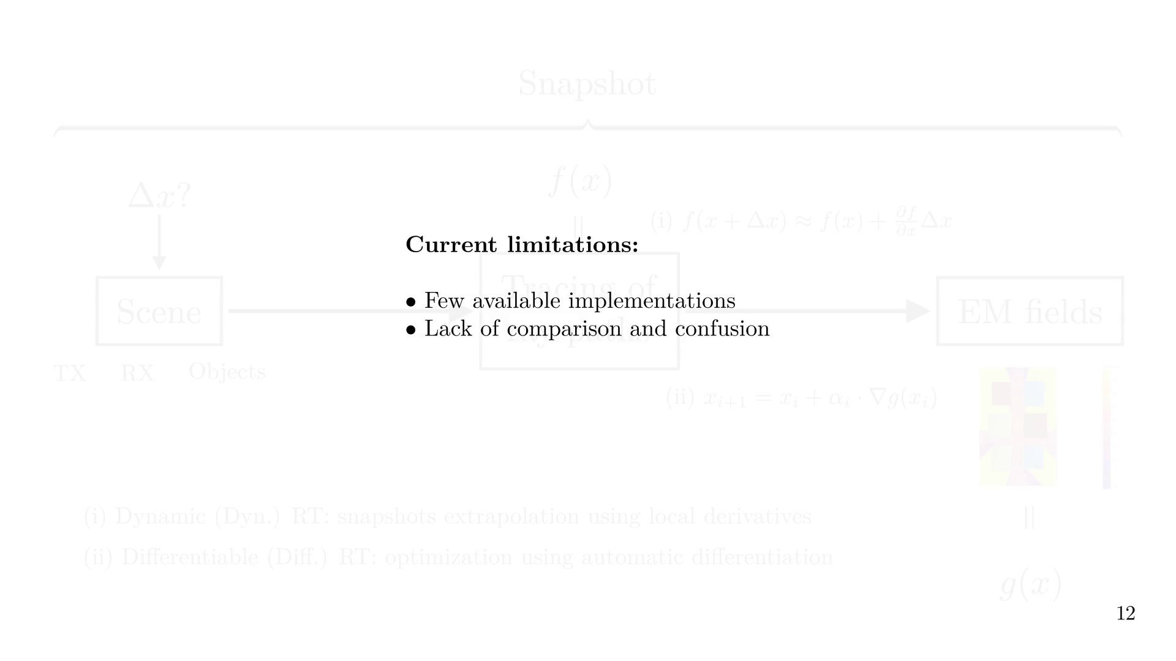

Slide 26


Slide 27
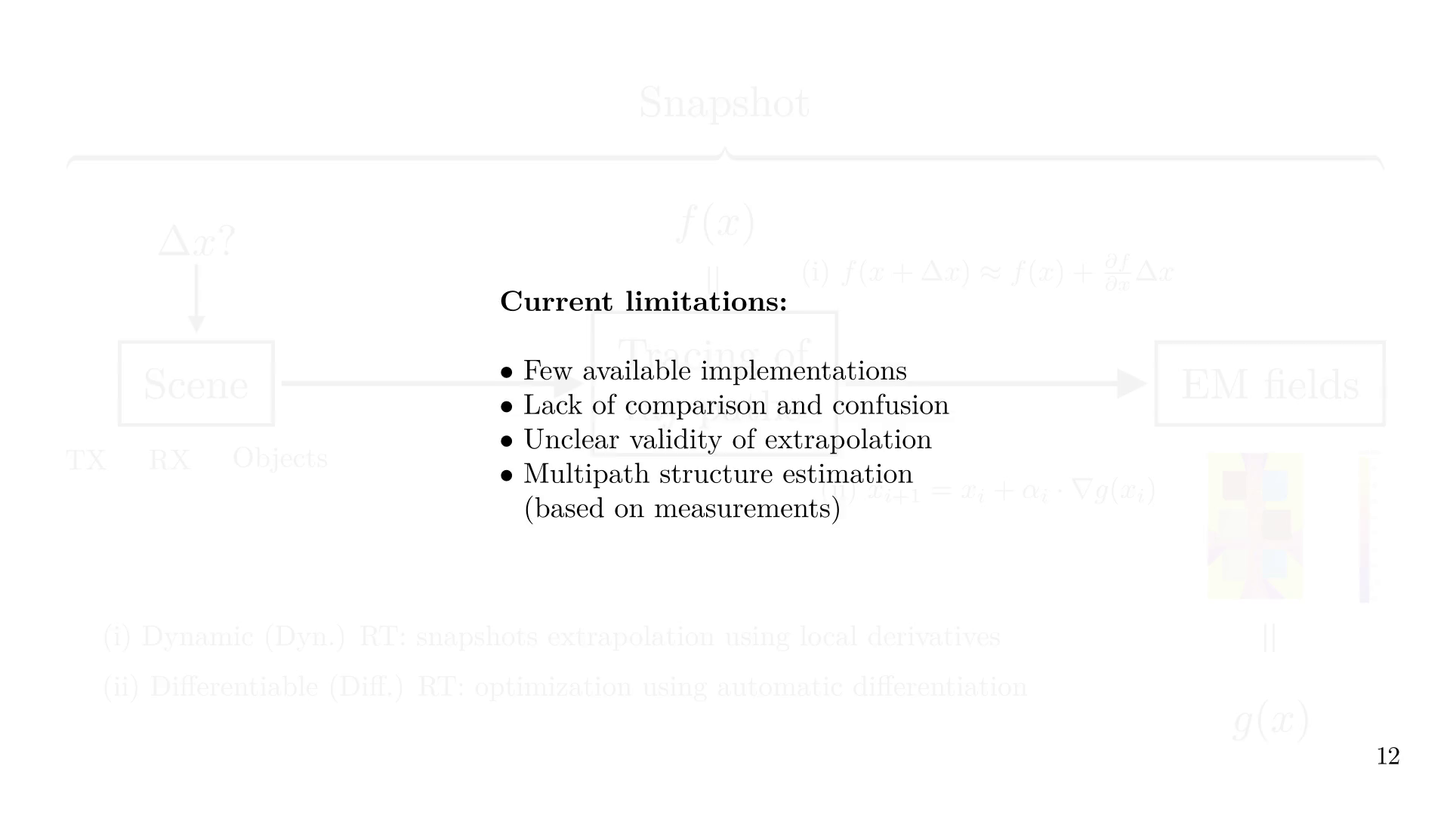
Notes:
Our contributions are as follows

Slide 28
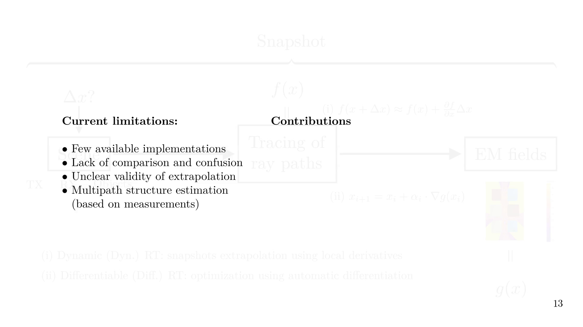

Slide 29
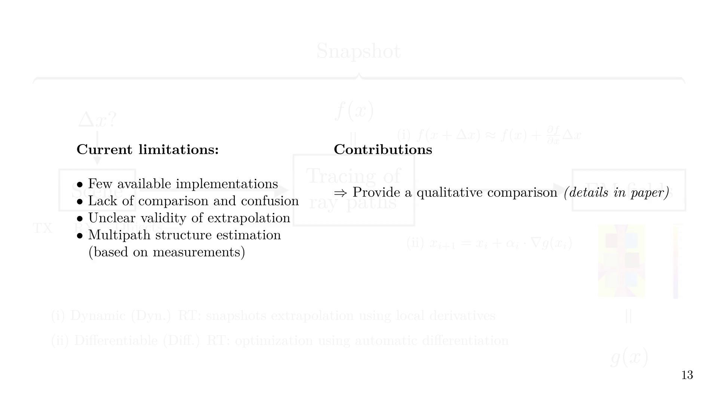

Slide 30
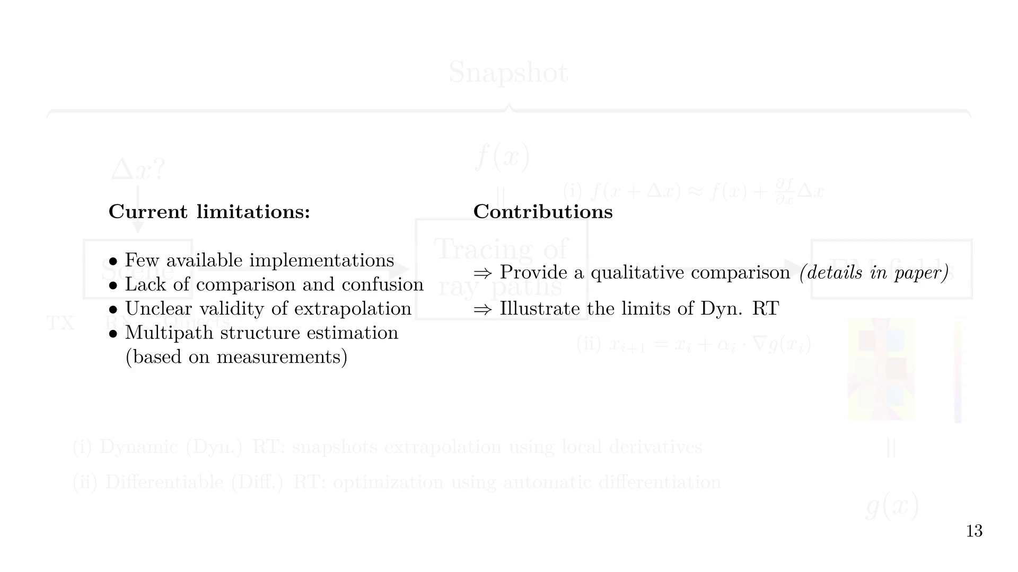

Slide 31
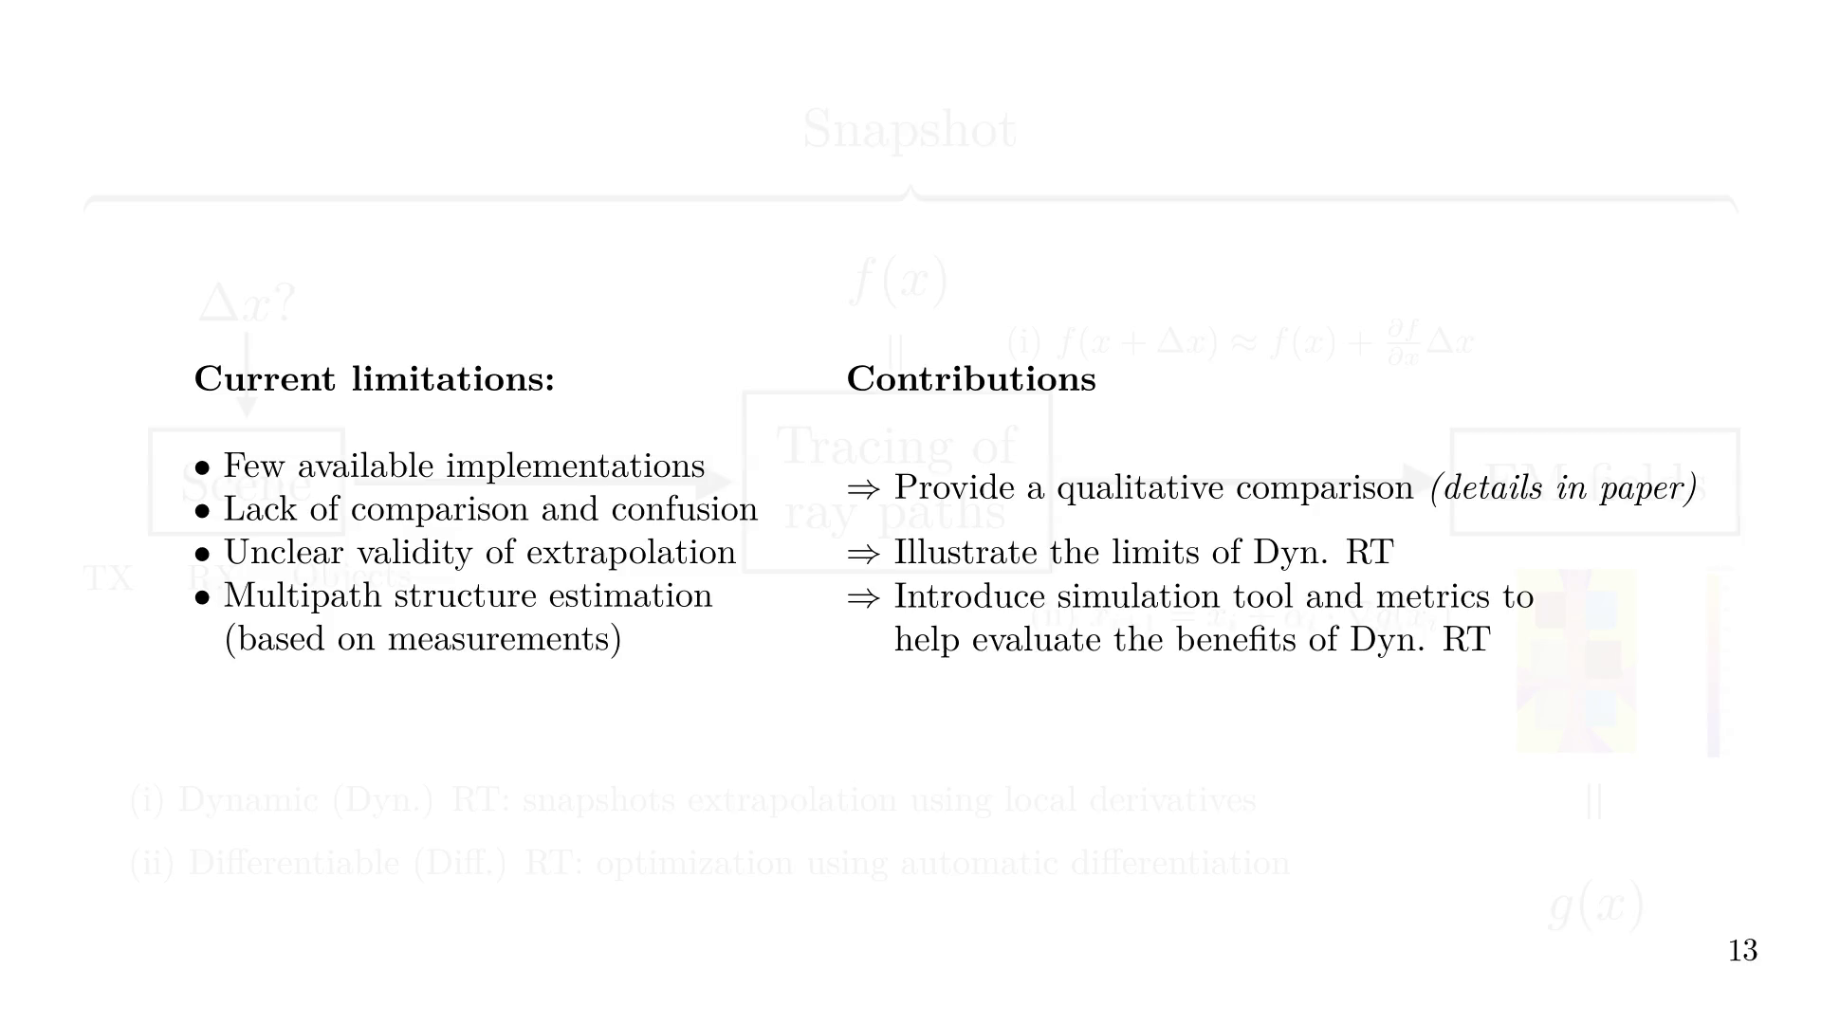
Notes:
Contents of this presentation

Slide 32


Slide 33
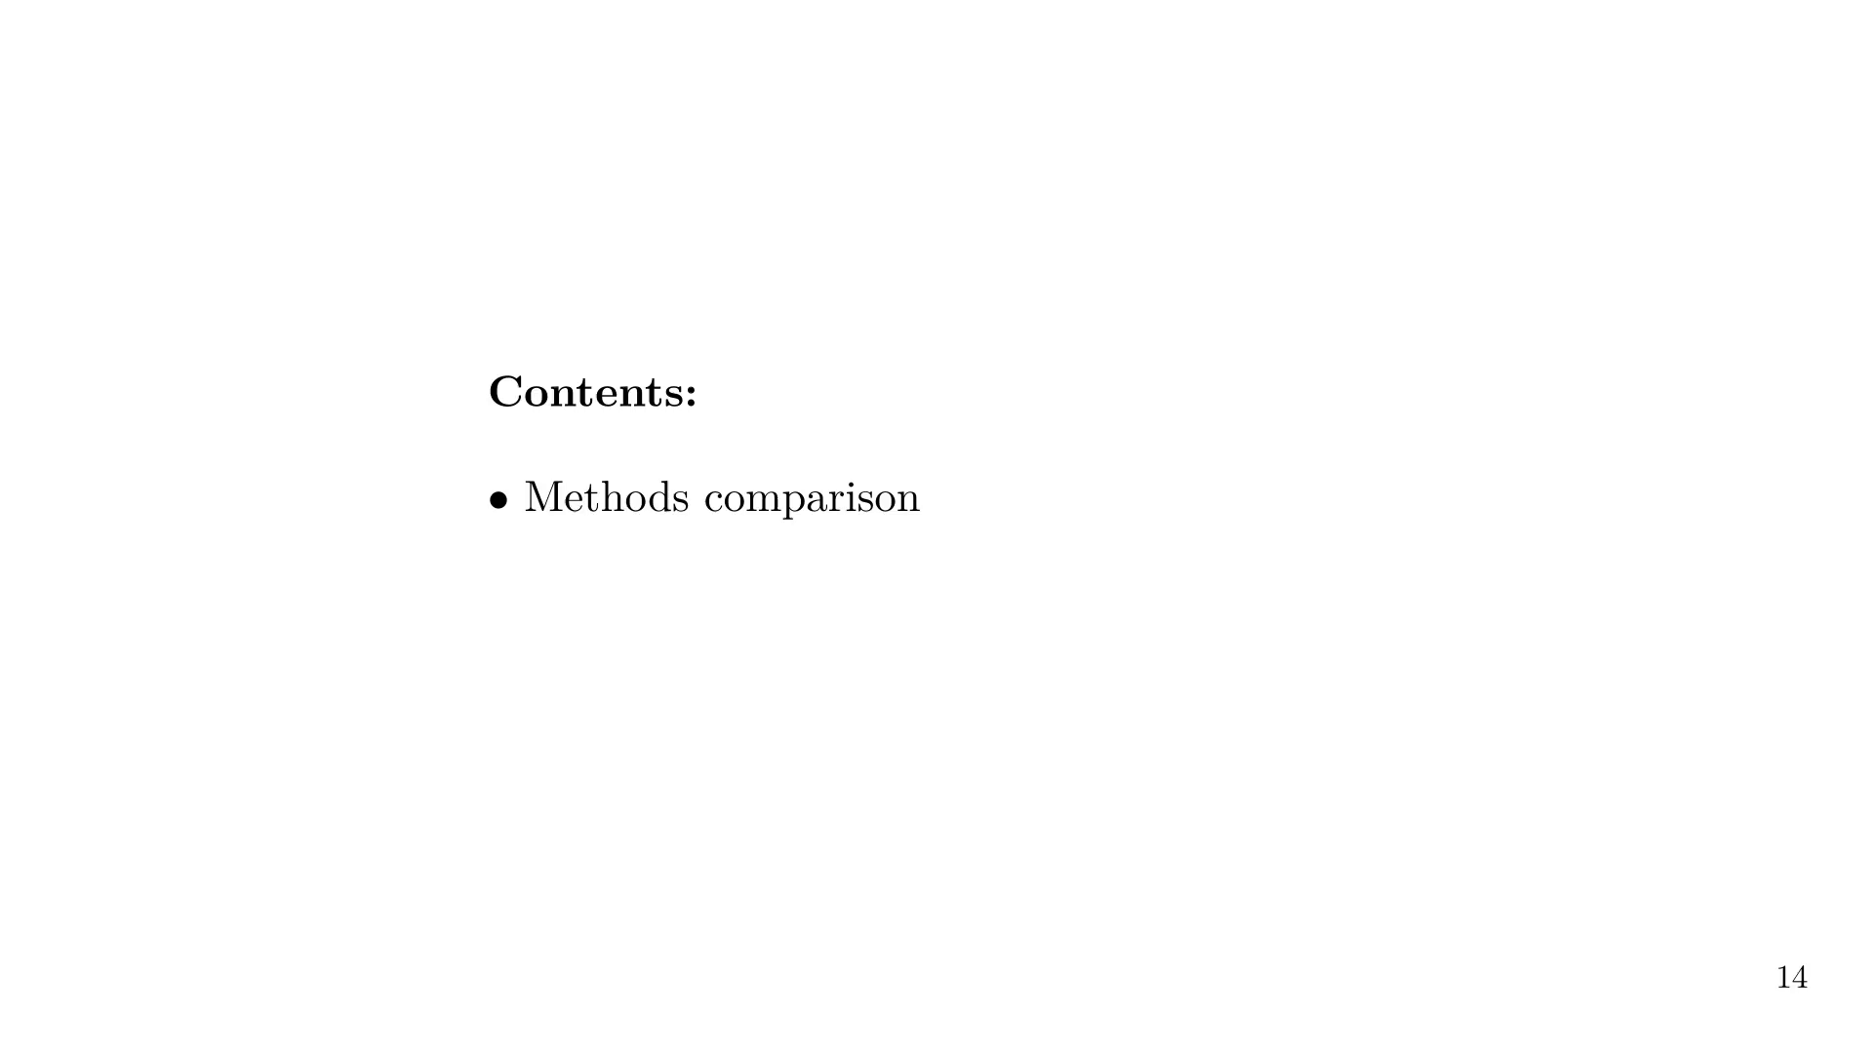

Slide 34


Slide 35
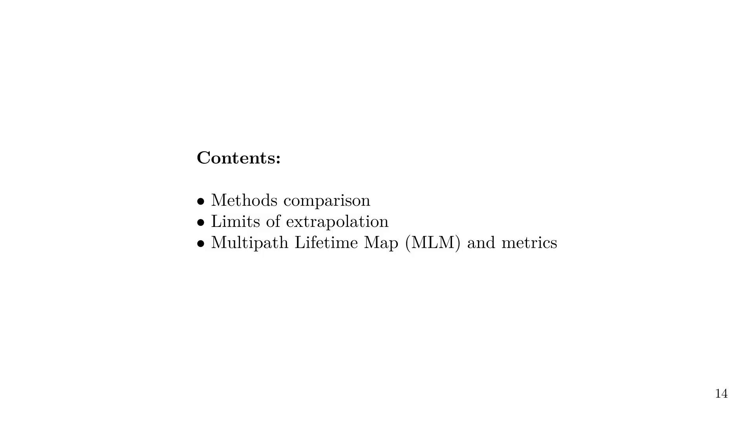

Slide 36
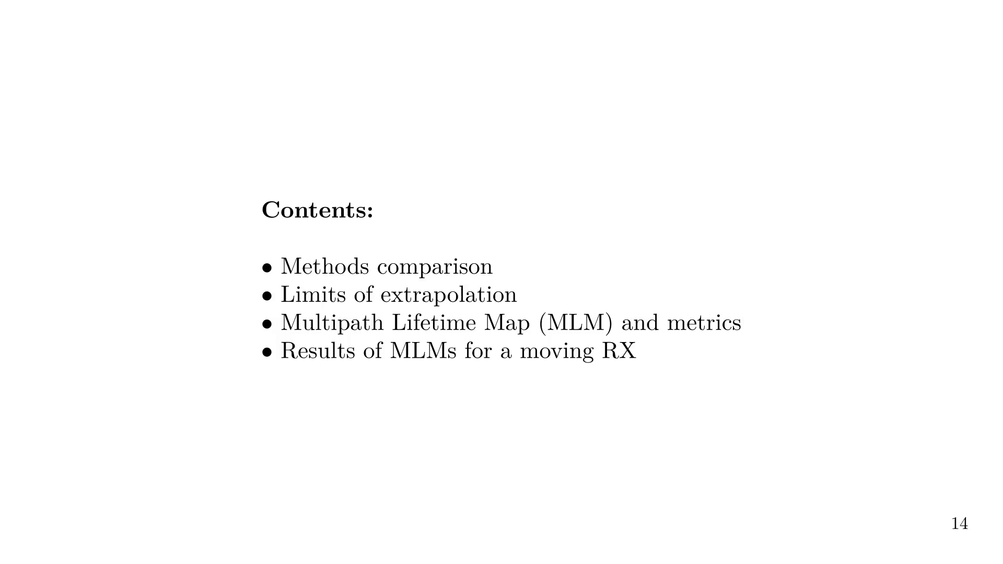
Notes:
We rapidly compare the two approaches

Slide 37
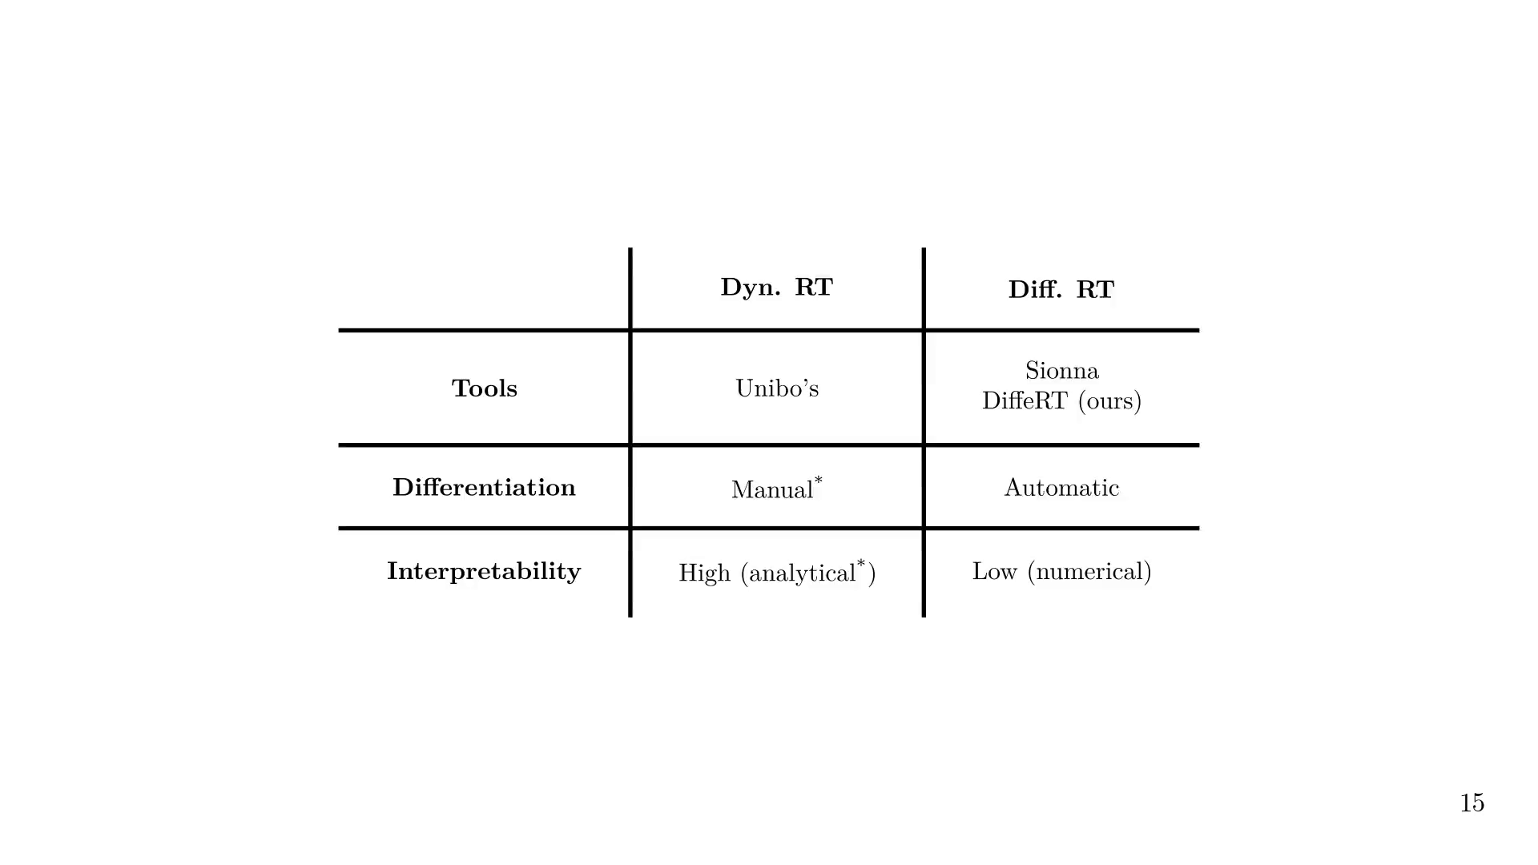
Notes:
We will use a simple example to illustrate the limits of snapshot extrapolation.

Slide 38

Notes:
When performing RT, each reflection order is computed separately.
E.g., the LOS path is computed first.
Here, the lid region is the area where a LOS path exists.

Slide 39
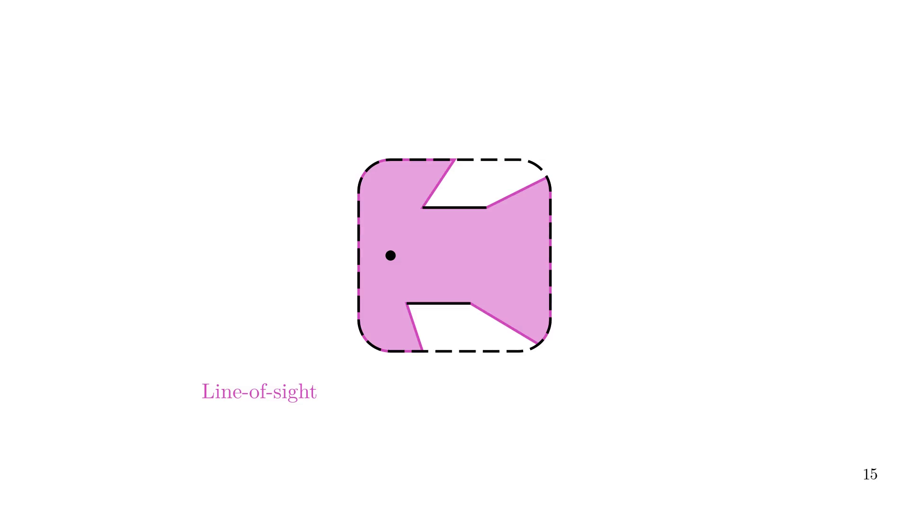

Slide 40
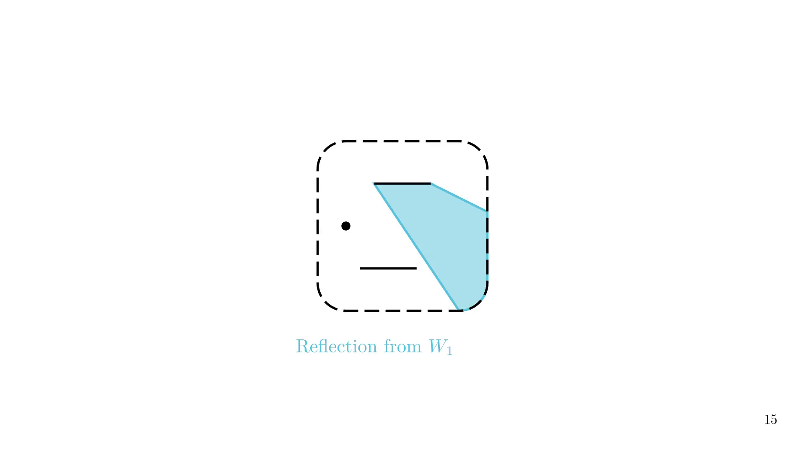

Slide 41
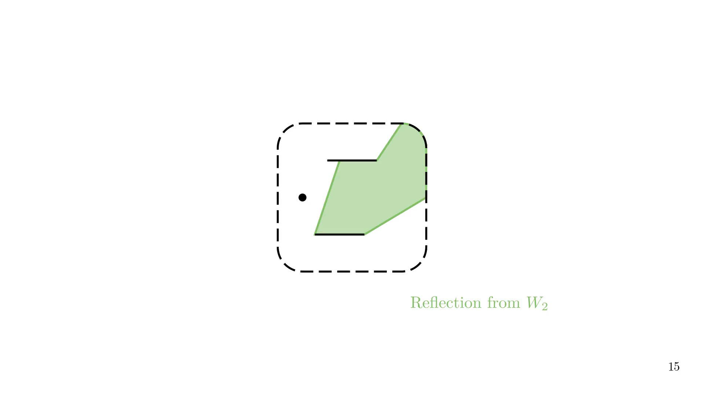
Notes:
Of course, ray tracing is not limited to first-order reflection.

Slide 42
Notes:
By adding contributions from all previous reflections, we draw the multipath cells.

Slide 43
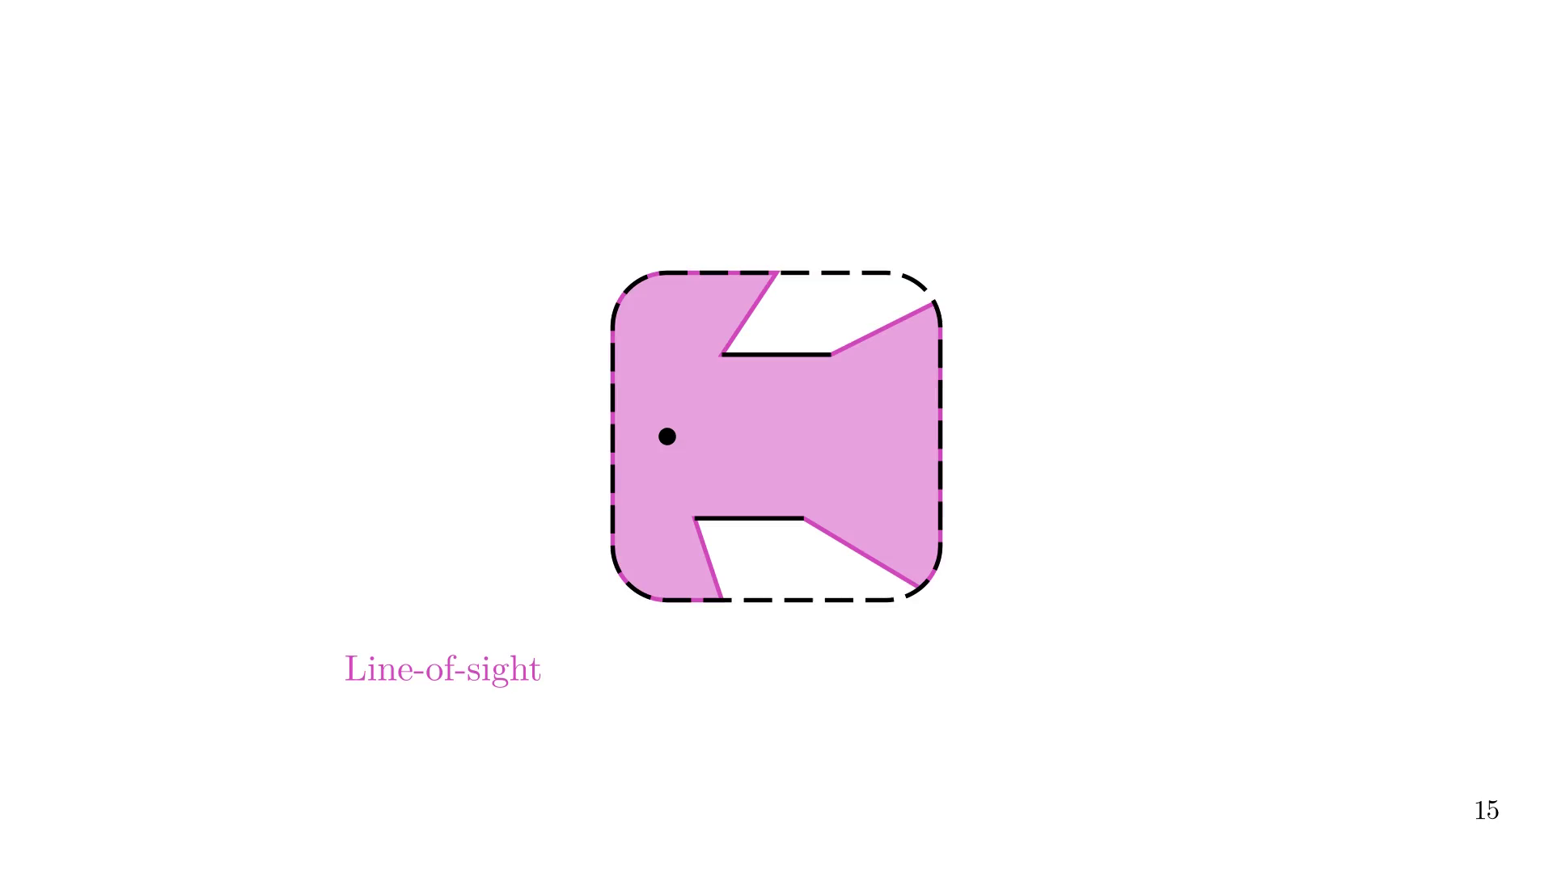

Slide 44
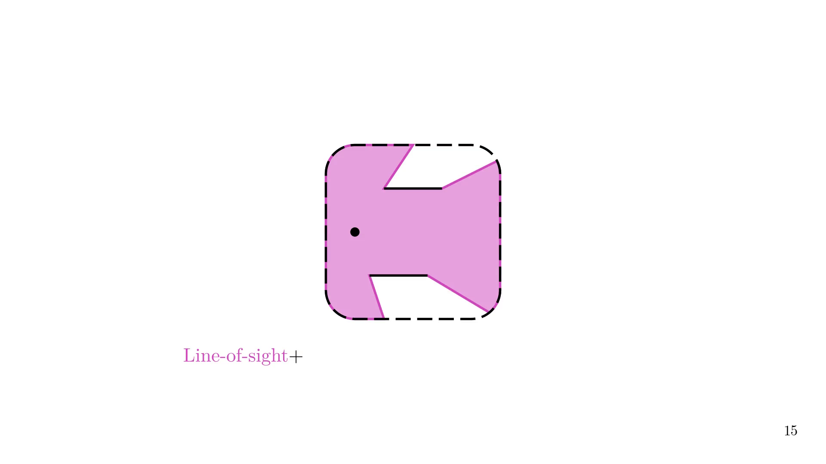

Slide 45
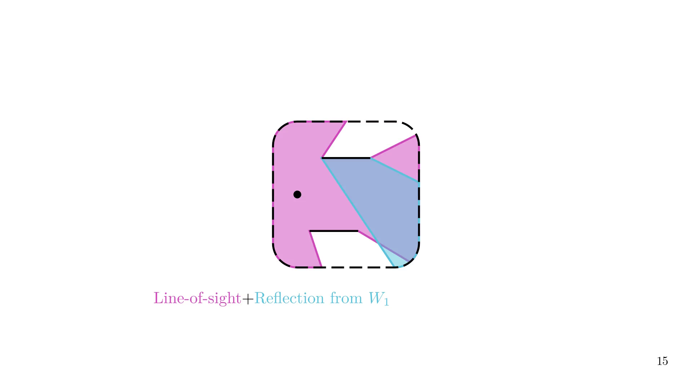

Slide 46
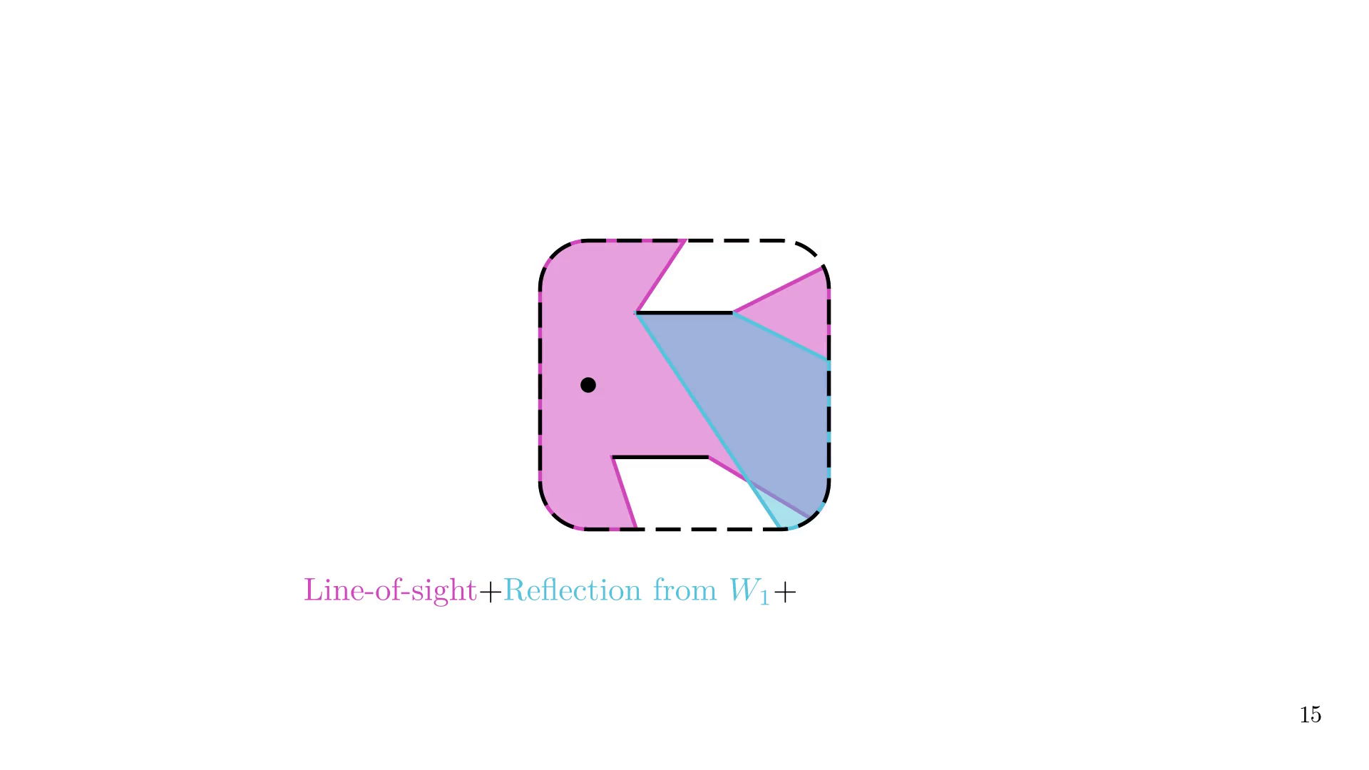

Slide 47
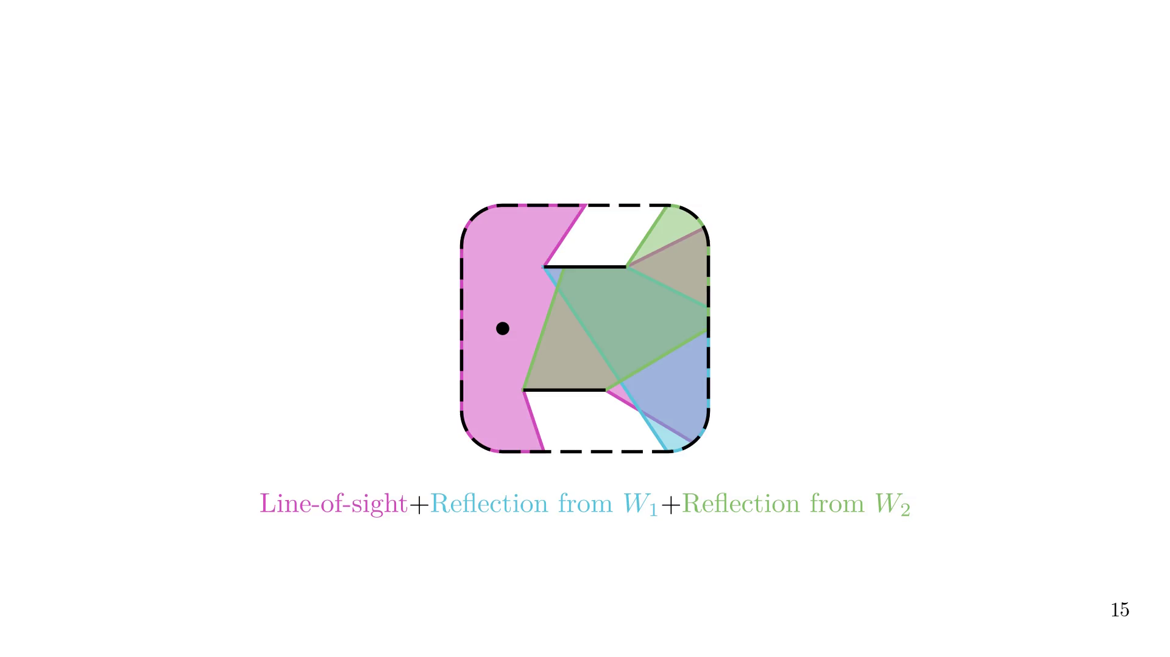
Notes:
The superposition of all cells if what we call the Multipath Lifetime Map.
A cell is defined as the area where the multipath structure remains the same,
and a cell can be split into multiple regions.

Slide 48
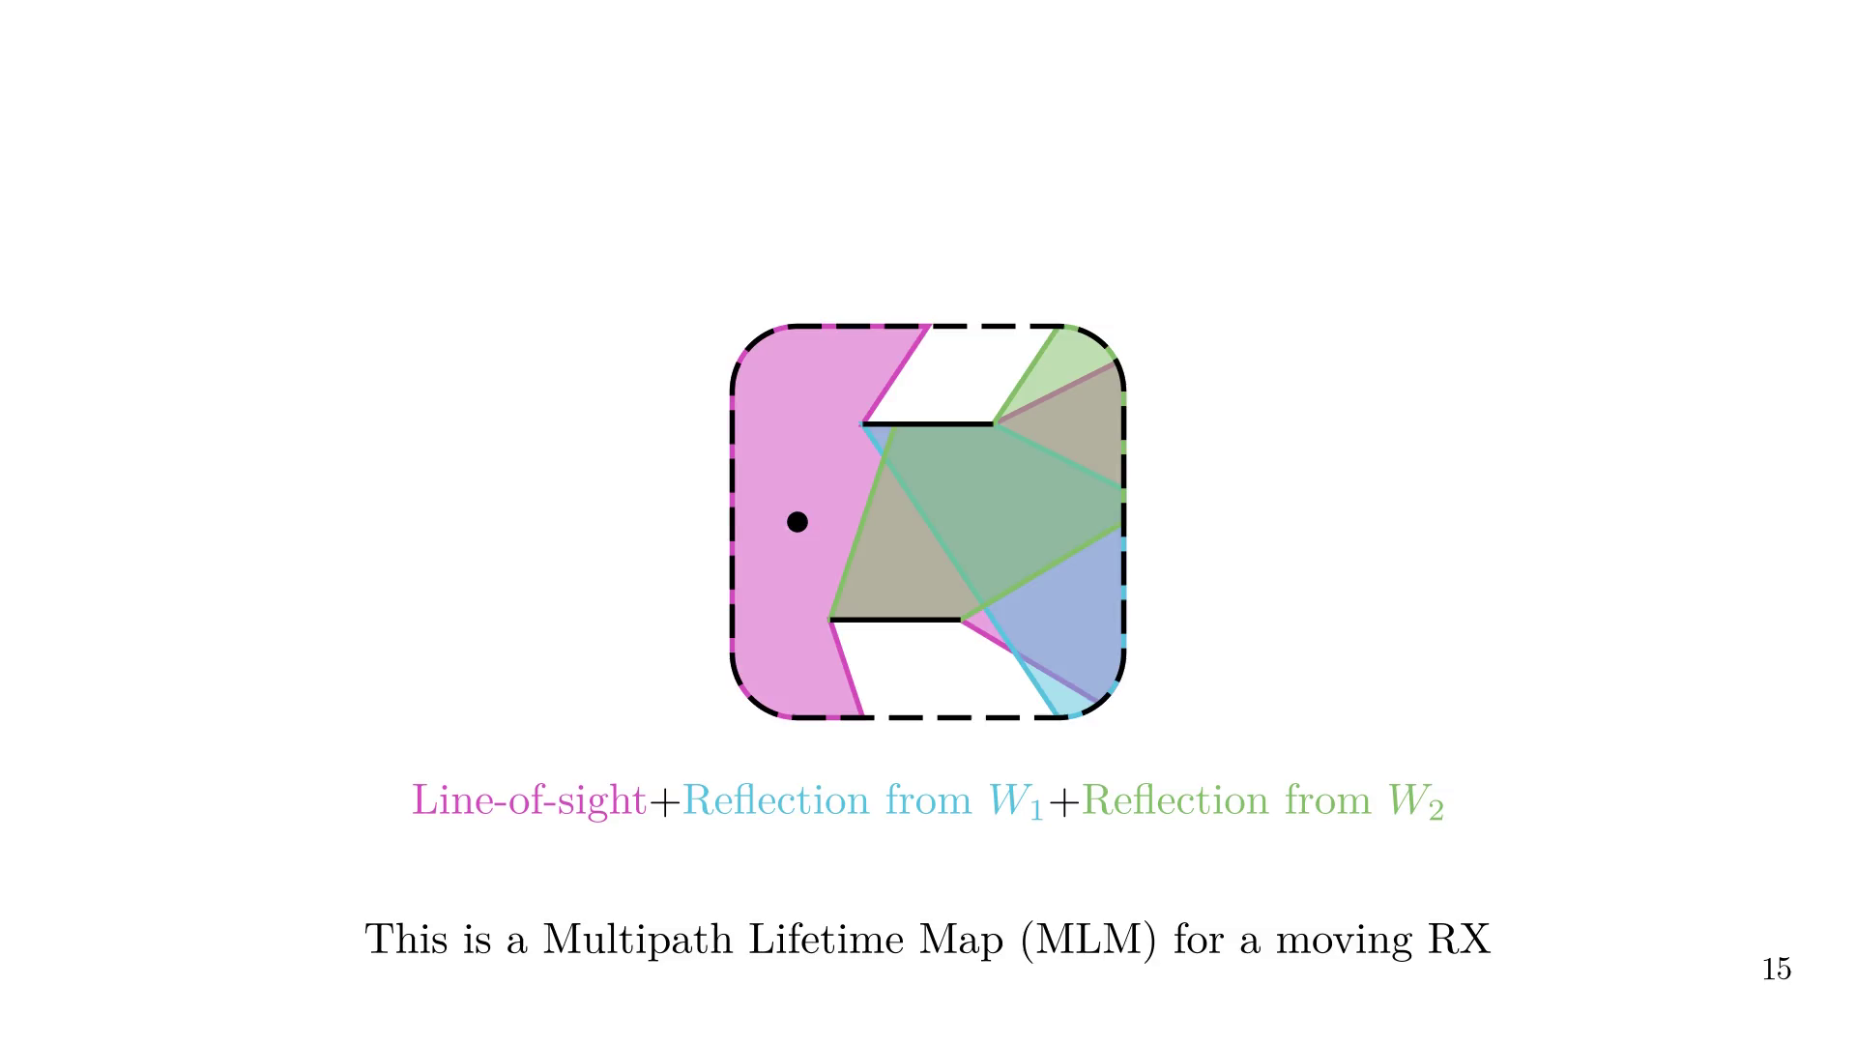
Notes:
And of course, the map changes when any other object, like TX, moves.

Slide 49
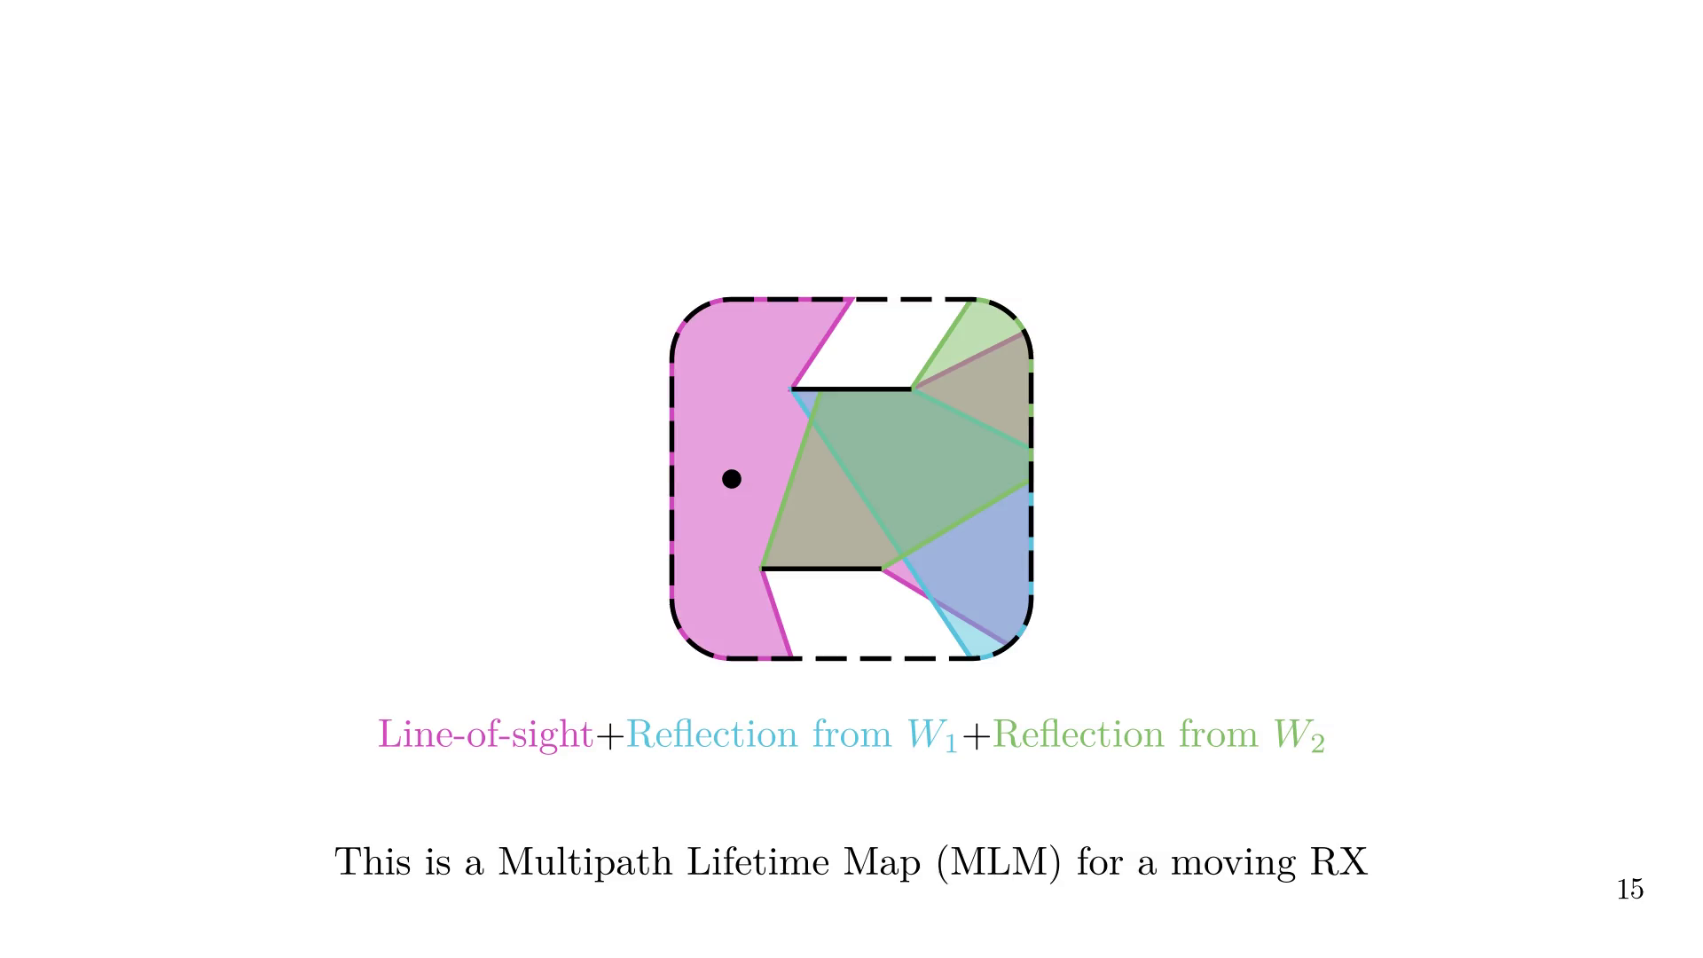
Notes:
Dummy slide after loop

Slide 50

Notes:
We define two metrics

Slide 51
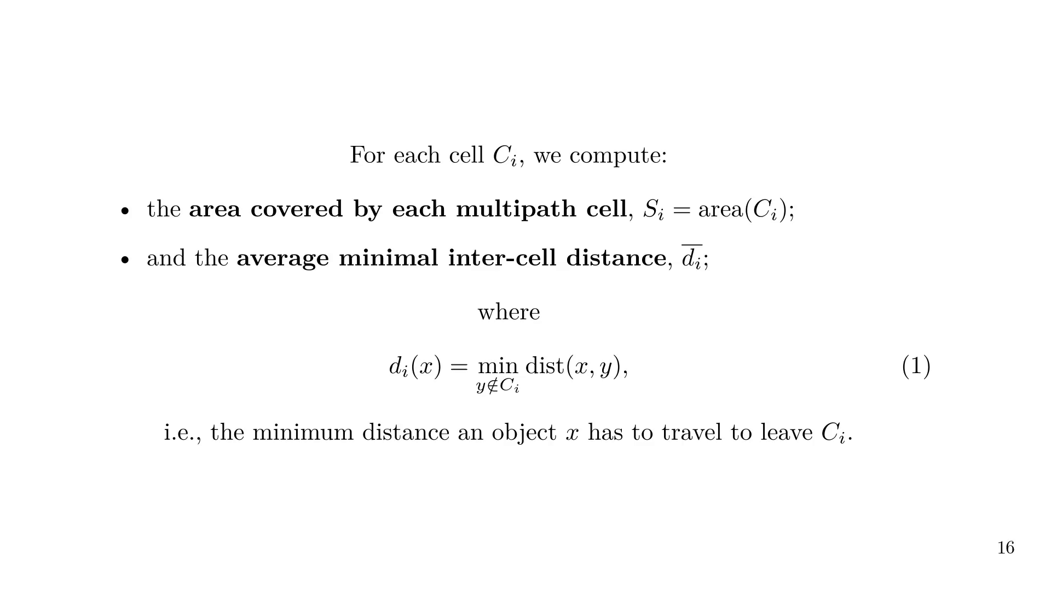
Notes:
In practice, how to we compute the MLM?

Slide 52

Notes:
We place a grid of RXs in the scene and identify each path component

Slide 53
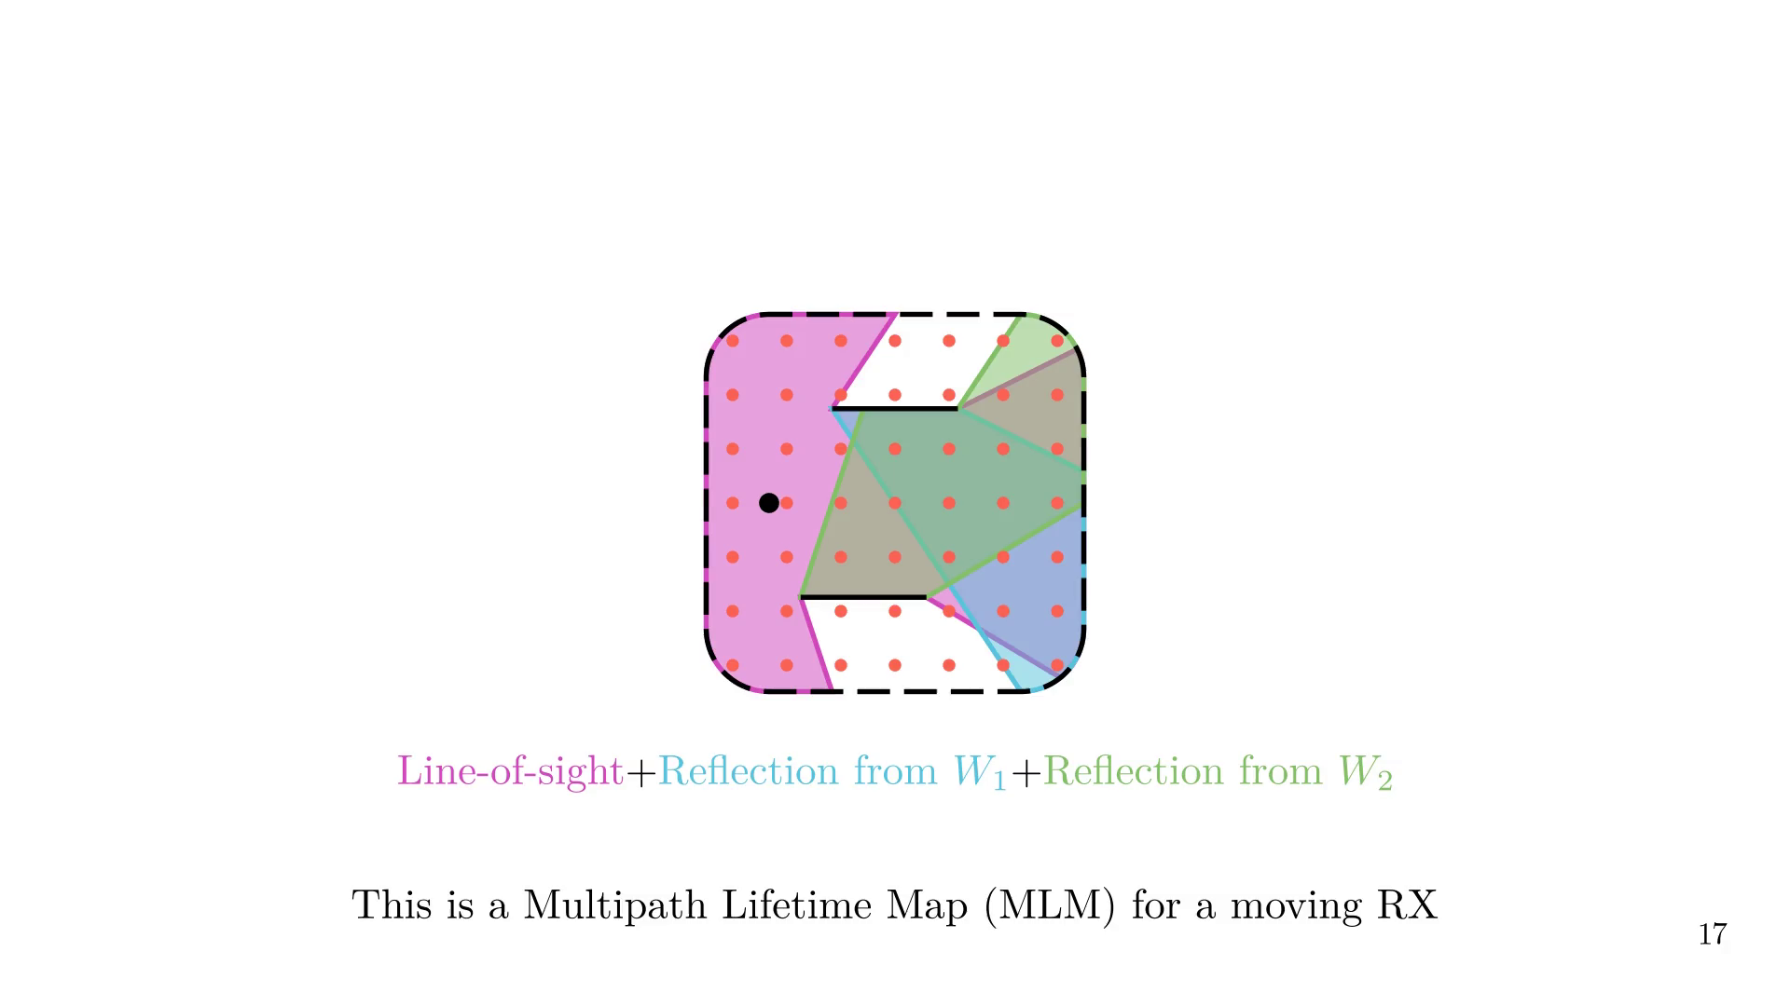

Slide 54


Slide 55


Slide 56
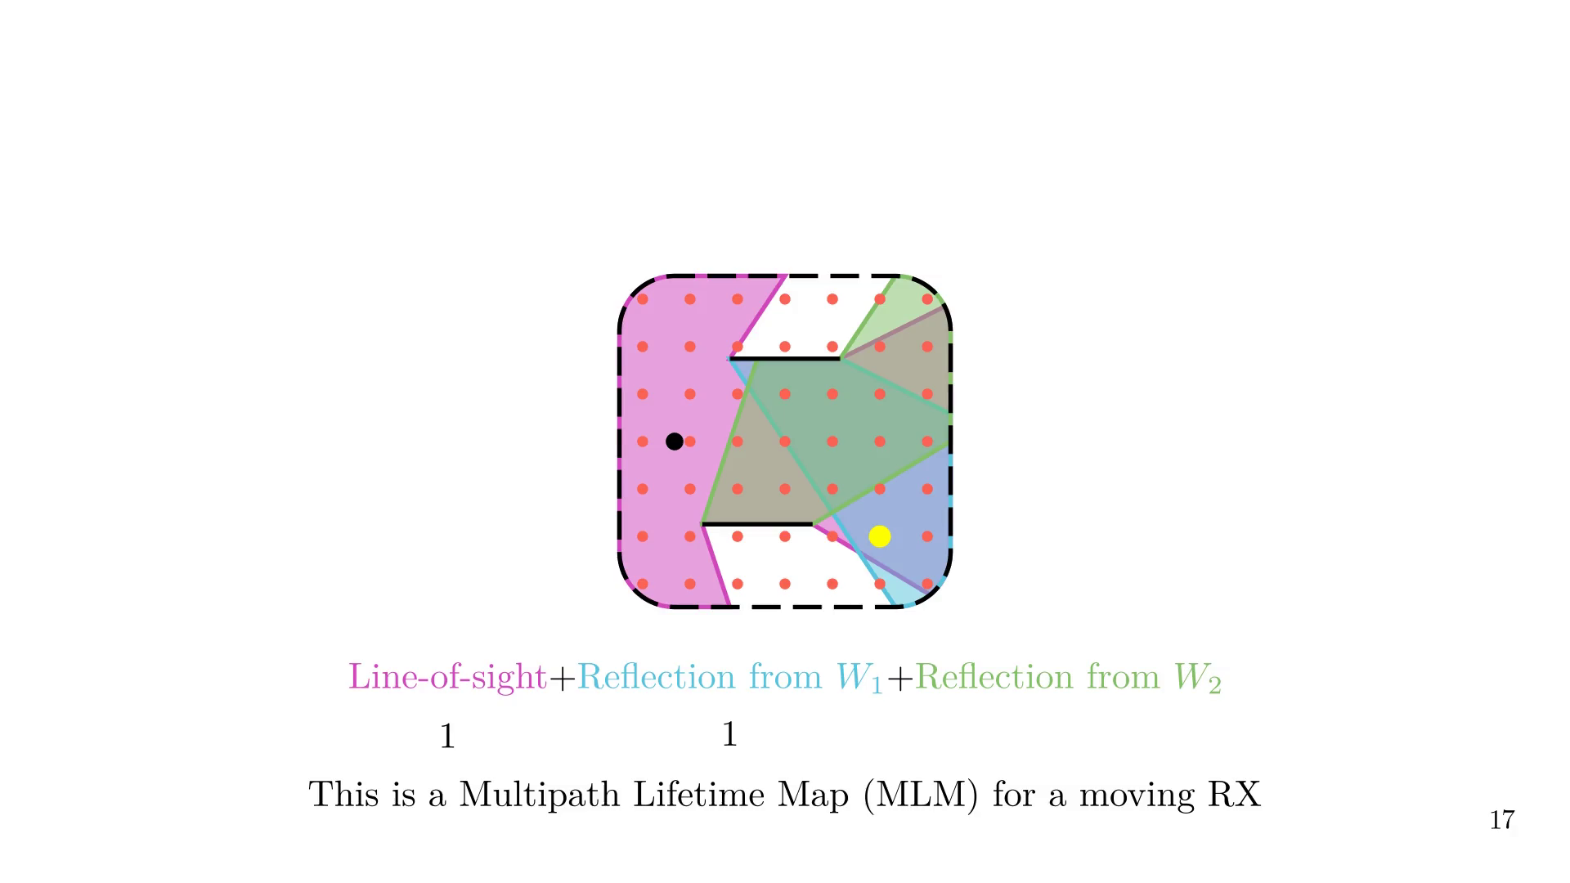

Slide 57
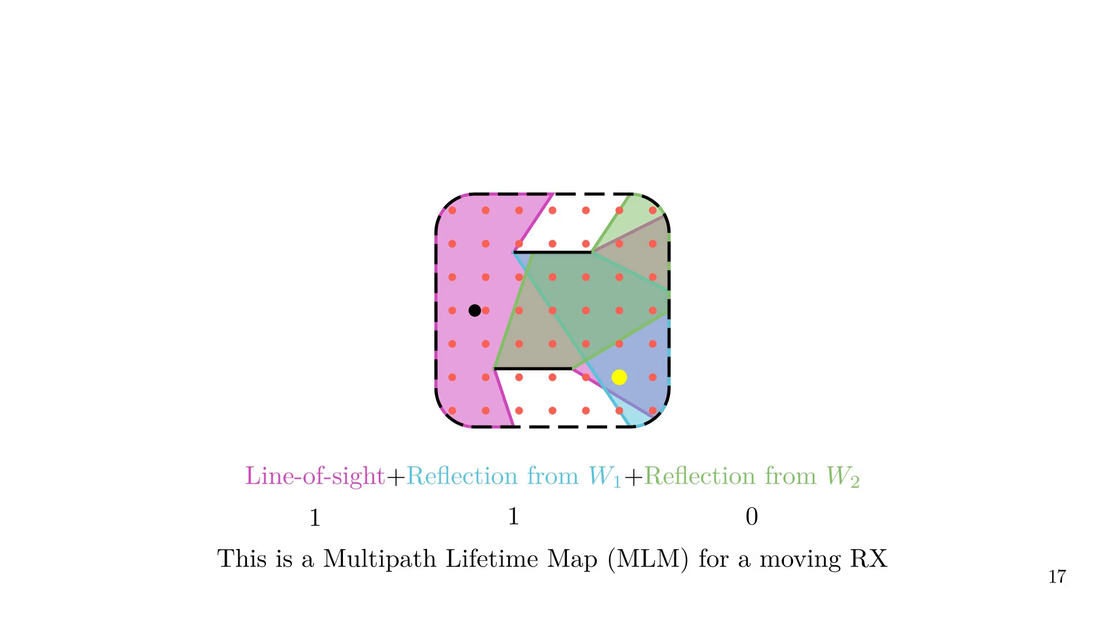
Notes:
We then repeat the process for all RXs, identifying uniques cells.
All the implementations details are available in the paper and in the provided tutorial.

Slide 58

Notes:
We can then compute the metrics.
If we know the density of RXs, the cell area can be estimated by counting the number of RX per cell.

Slide 59
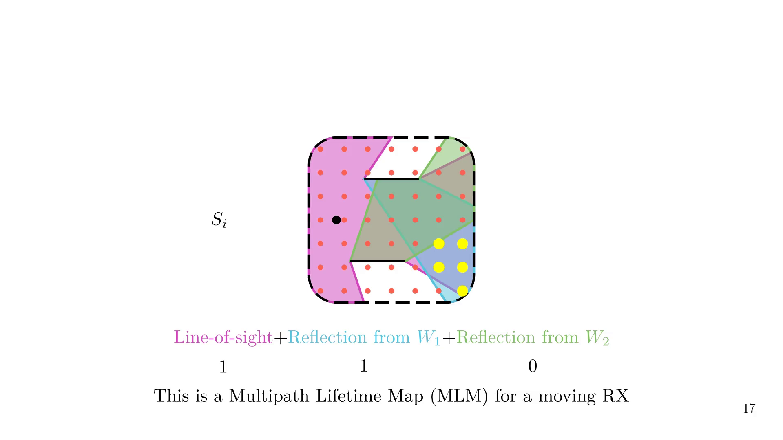
Notes:
We then compute the distance to the closest RX that is not in the same cell,
and average the distance over all RXs in the cell to obtain the
average inter-cell distance.

Slide 60
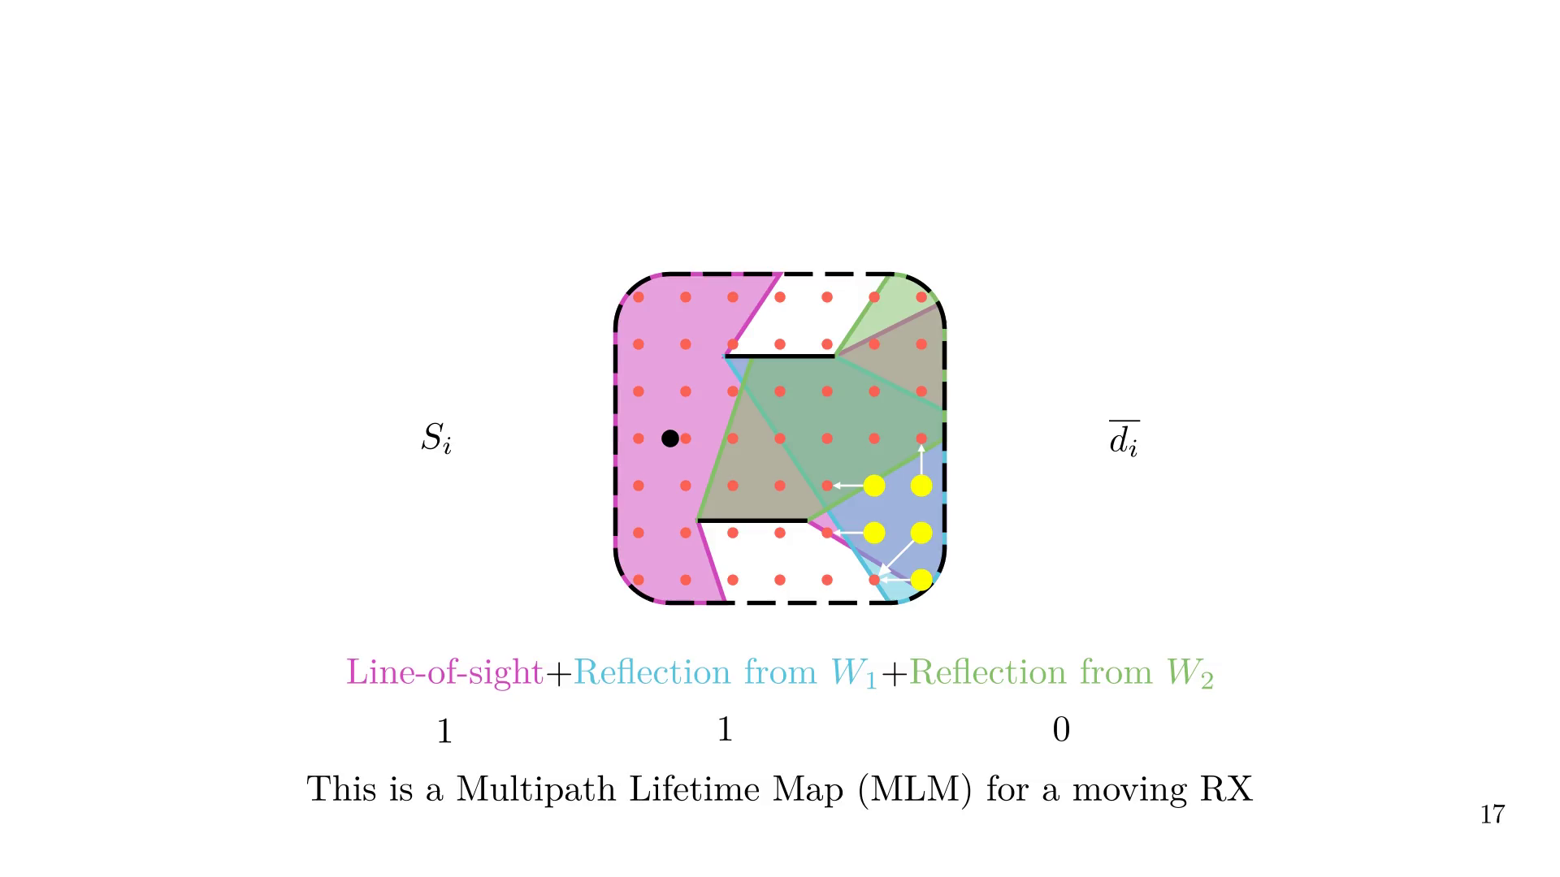
Notes:
# MLM example

Slide 61
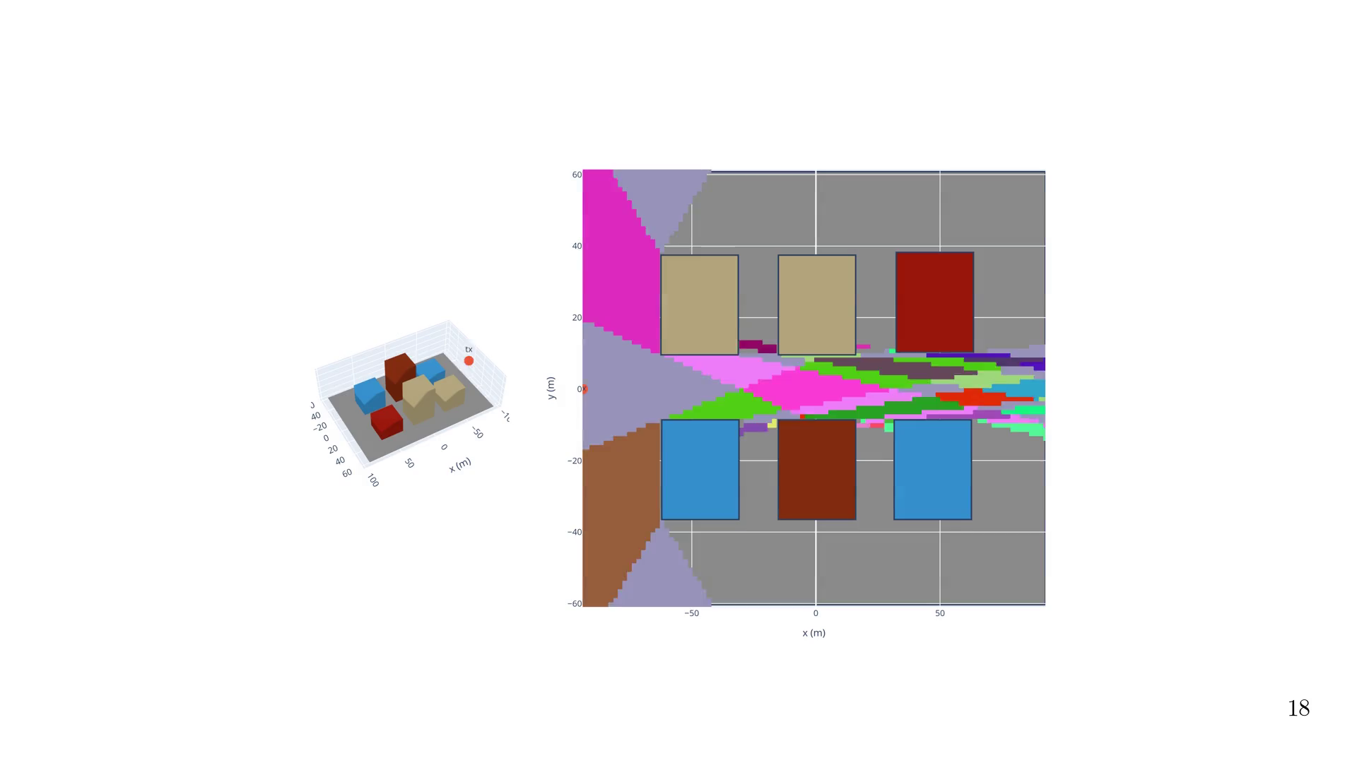
Notes:
Animate MLMs

Slide 62

Notes:
A discussed in the paper, metrics shows similar results to what is obtained from measurements of the coherence distance, time, stationarity, etc.

Slide 63

Notes:
Let's wrap up

Slide 64


Slide 65
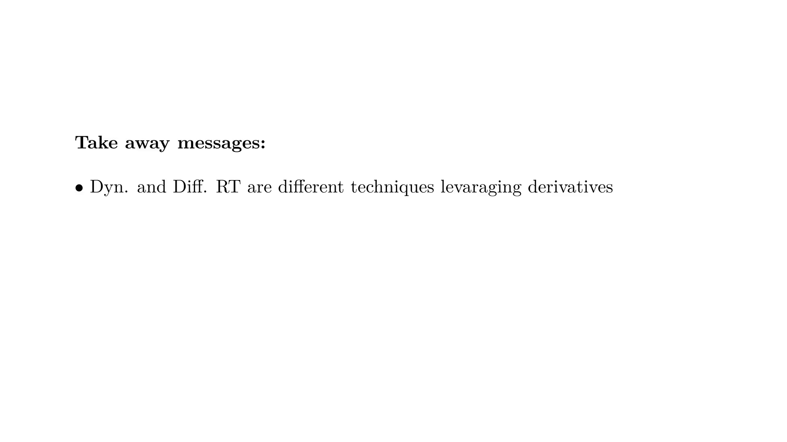

Slide 66
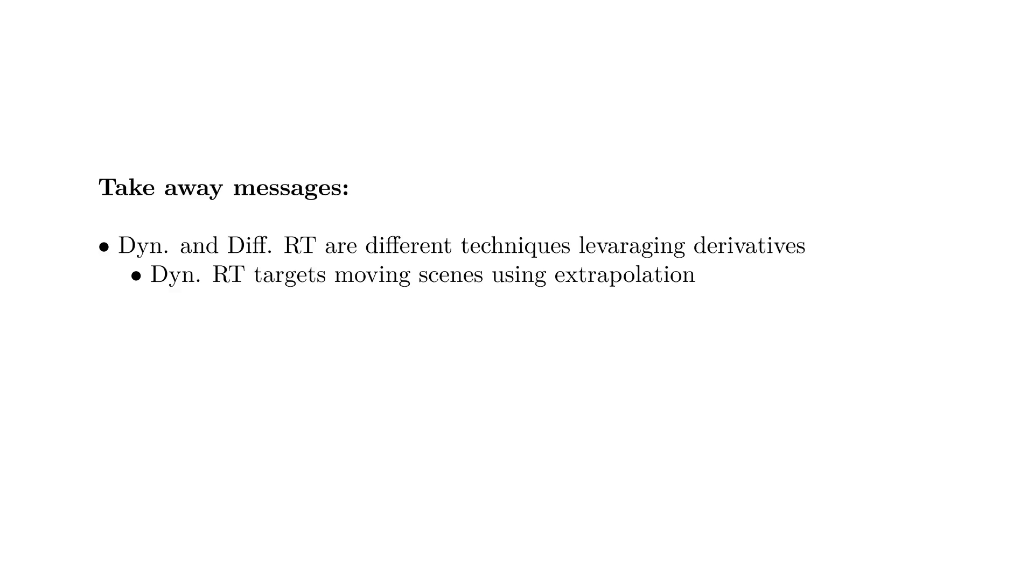

Slide 67


Slide 68


Slide 69


Slide 70

Notes:
Finals words

Slide 71

Notes:
Histogram

Slide 72

Notes:
Table

